Slide 1


Slide 2




Slide 3







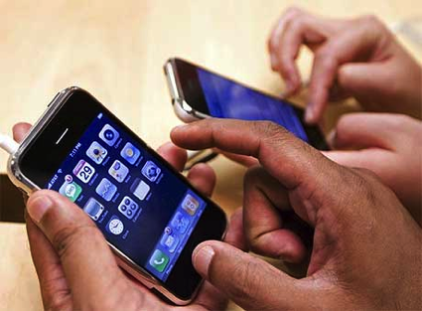



Notes:
The Facebook generation is not going away any time soon, and certain behaviors specific to this generation and it’s parents may actually increase. Such as the use of smart phones, the time in front of screens, etc. Certainly blaming an inanimate object for this inactivity levels and obesity in our society is not appropriate. It is our attitudes and values that dictate our collective sedentary behaviours.

Slide 4
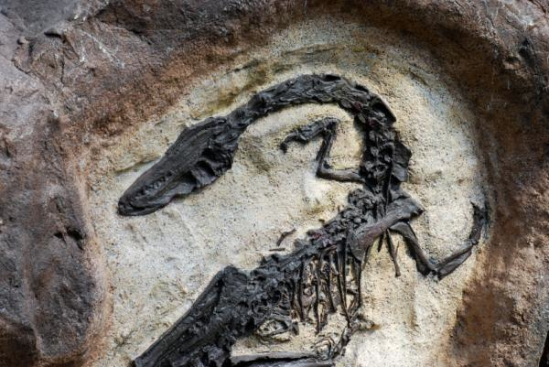
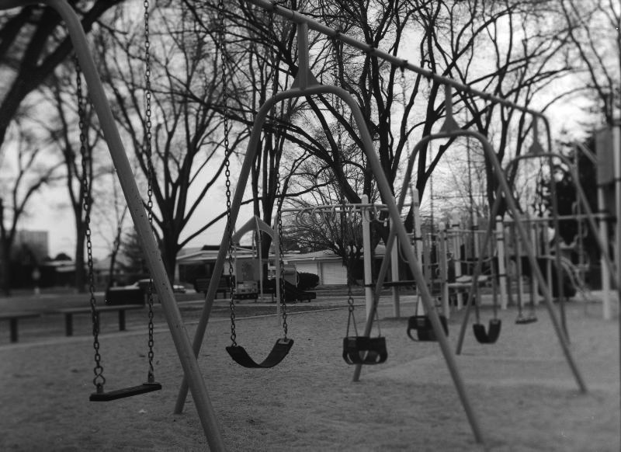
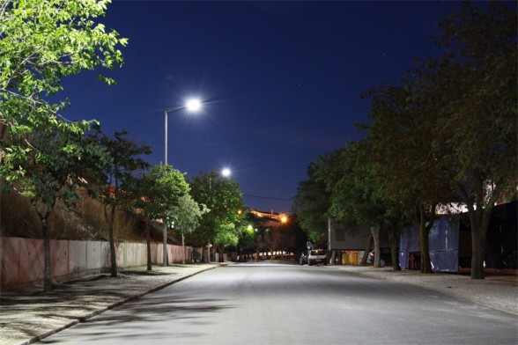
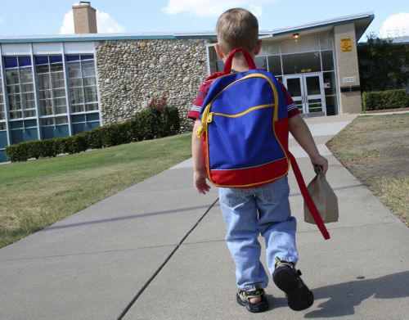
Unstructured play is EXTINCT! Gone the way of the dinosaur.
Playgrounds empty!
“Come home when the street lights come on!” never to be heard again!
“Walk to School” has been eradicated in ONE generation. 2000 steps a day gone.
Notes:
Low structured or no structured play is almost absent in our children, due to liability concerns, diversion toward structured activities, and anti-bullying. As a result we still make (spend funds) on playgrounds and structures that often stand empty. Our urban and sub-urban children are being driven to school more often nowadays, and unwarranted fears of safety are often heralded as the reason. Plus our JUST IN TIME mentalities make us always rushing from one venue to the next – so the car becomes the option of choice instead of two feet. Finally we tend to provide far too much oversight over our children, helicopter and bubble parenting. We don’t really need to see every game or activity, especially if we are jst sitting around watching – not good role modeling!!

Slide 5
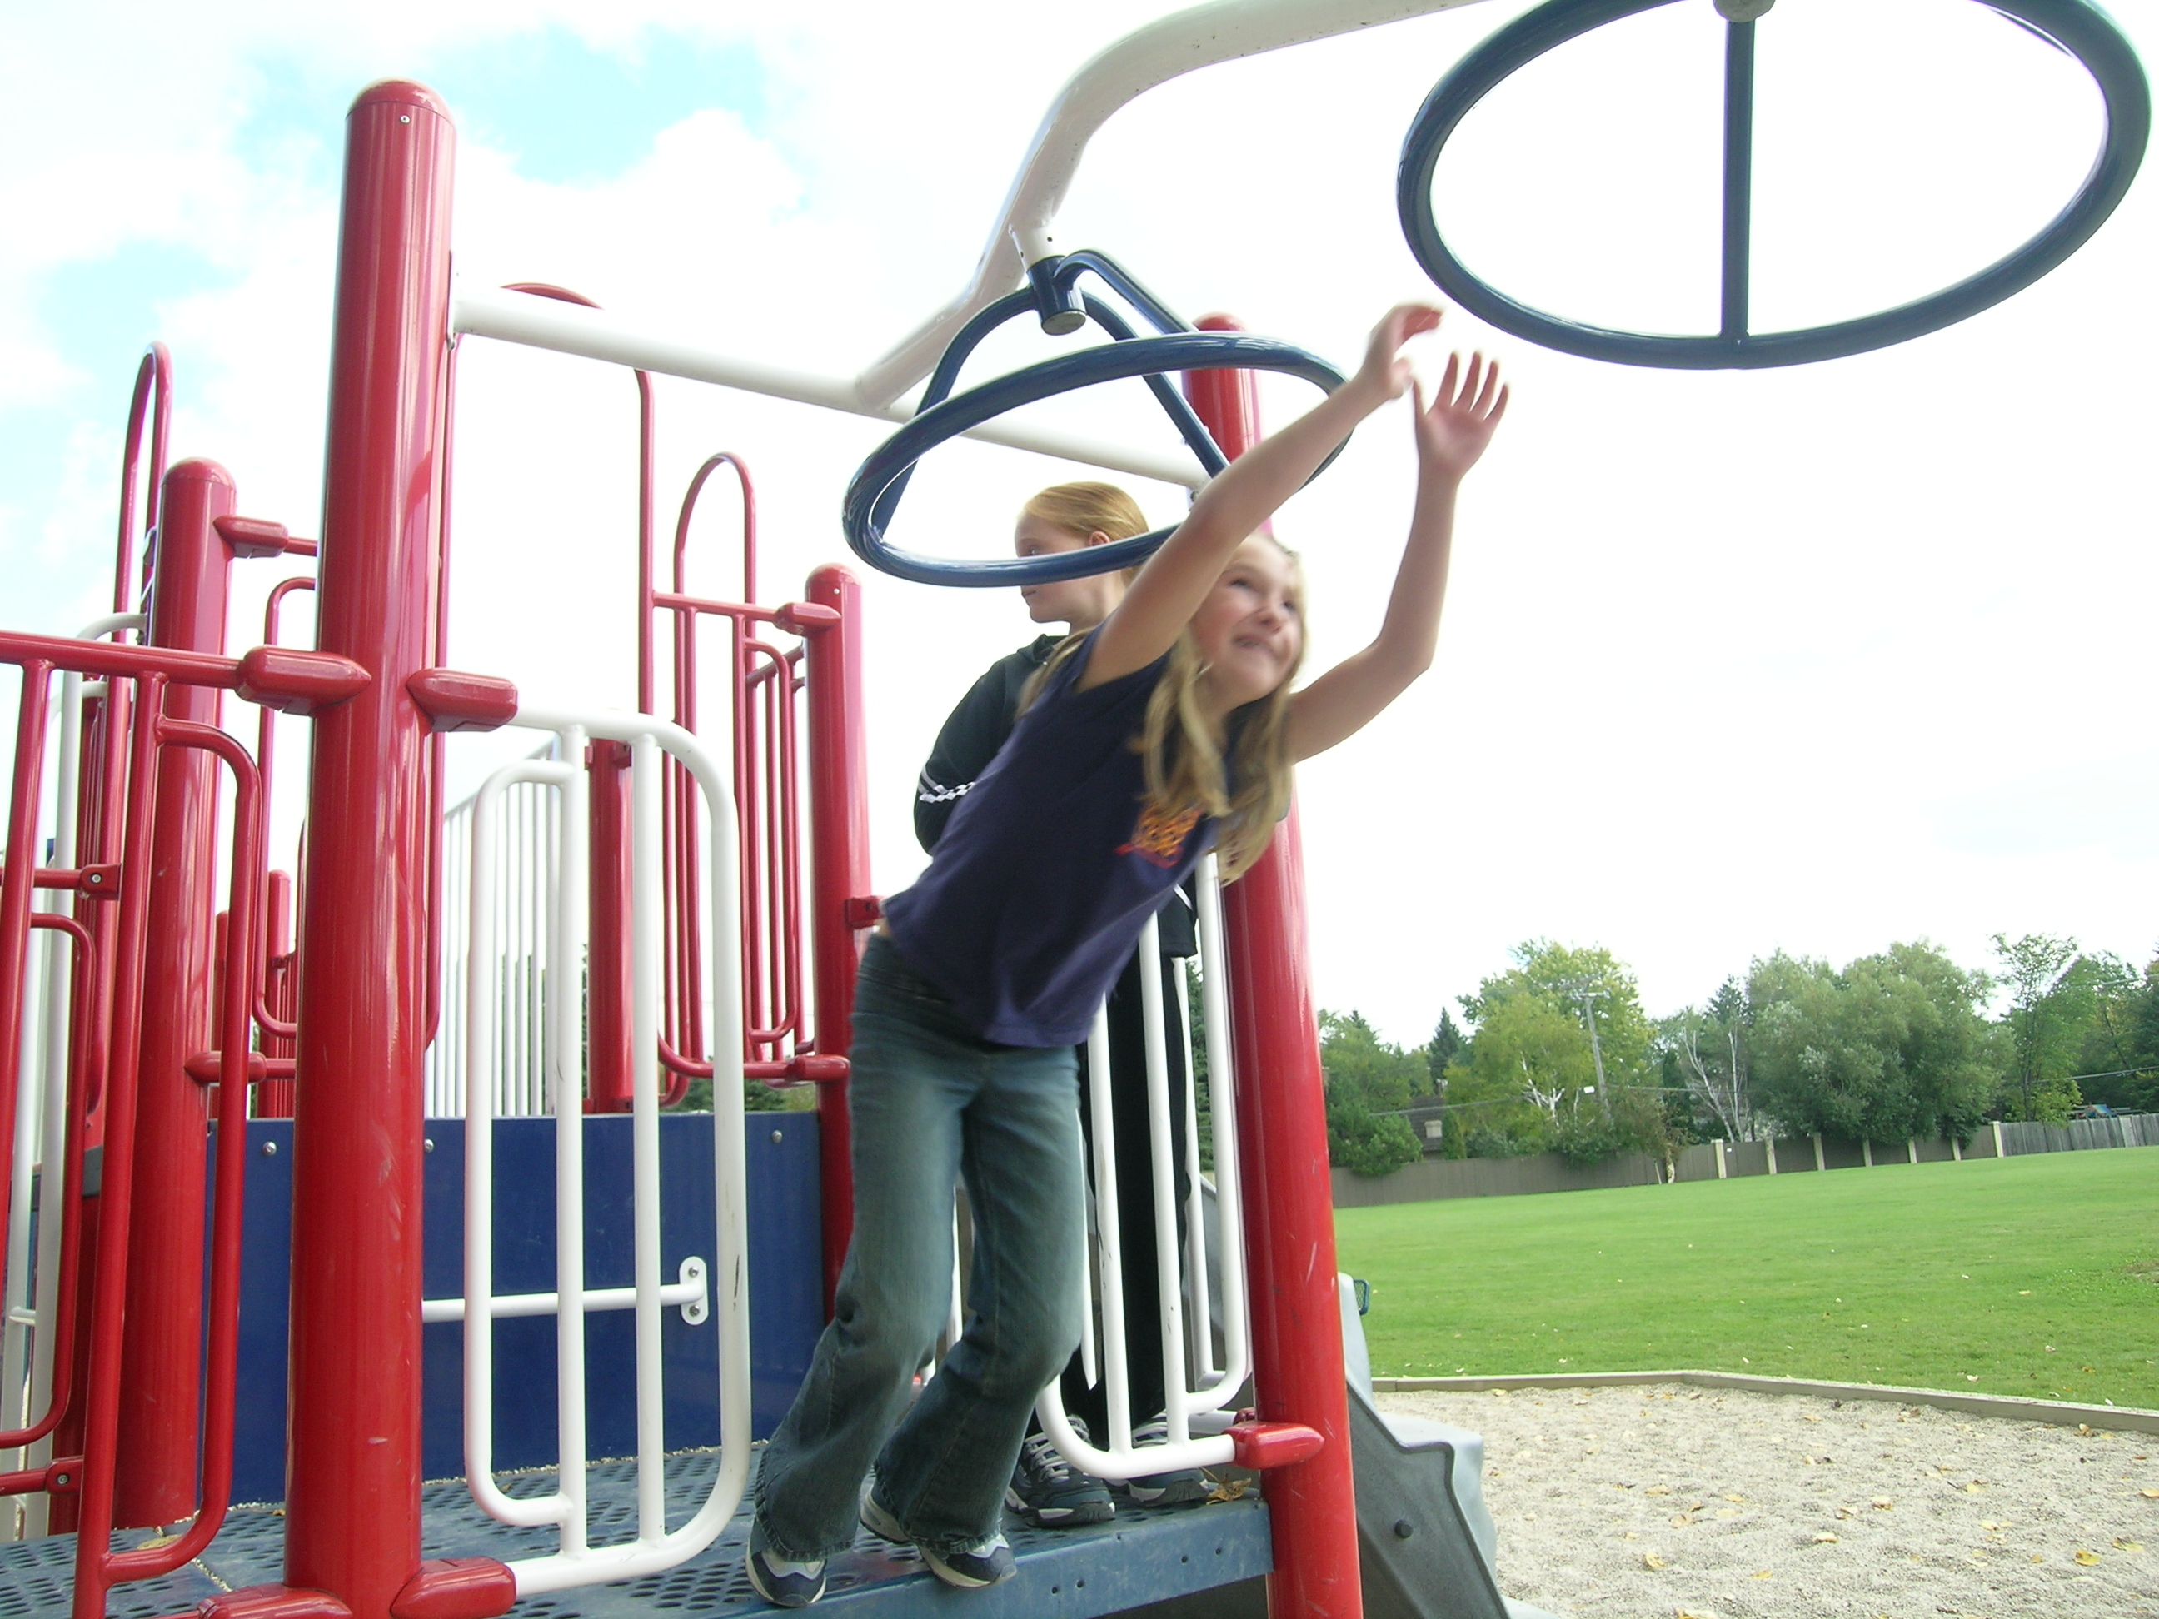
What percentage of people are active enough? Meeting minimum age guidelines. US Accelerometer data.
Age | Males | X | Females
6–11 | 48.9 | 41.8 | 34.7
12–15 | 11.9 | 7.65 | 3.4
16–19 | 10 | 7.7 | 5.4
20–59 | 3.8 | 3.5 | 3.2
60+ | 2.5 | 2.4 | 2.3
-16% drop in PA 2008 to 2011
(Manitoba accelerometer)
5% or 15% Canadian
Canadian Data
52% of people self-report they are active enough! 10.9X over-estimate!
Notes:
Activity levels drop precipitously with the onset of puberty and stay low through adulthood. Even in manitoba where there is mandatory K to 12 phys ed with mostly specialist teachers and a high number of PE classes per week we have observed a substantial drop in activity over a few short years! Self report of physical activity is just a perception- there is a substantial mismatch between what we perceive and what happens in reality.

Slide 6
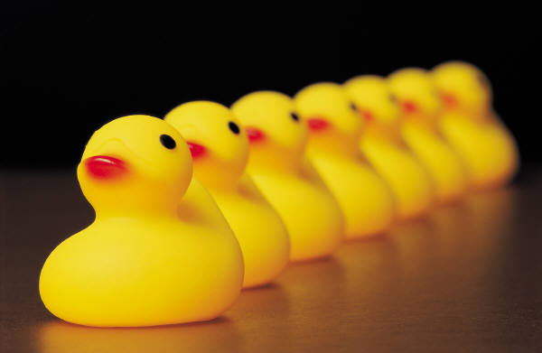
WANT TO
SHOULD DO
MUST DO
STOP
DYSFUNCTION
Notes:
6
We want to be active, we should be, but more than ever we MUST be.

Slide 7
Osteoarthritis (OA)
Total Knee Replacement
The odds ratios or “likelihood” for OA ranged from 0.1 for lean individuals to 13.6X (95% CI, 5.1 to 36.2) for morbidly obese individuals (BMI>36).
About 3500 total knee replacements per million per year. A very large percentage (50-80%) of these replacement are attributable to obesity!
We could reduce ½ the tragedy & suffering, ½ the cost.
Notes:
There are many conditions related to physical inactivity and obesity. One is knee and hip replacements (joint arthroplasty). If physical literacy is the gateway to active participation, then it stands to reason (but as yet not scientifically tested) that this would make more active, fit population and reduce conditions like osteoarthritis and the subsequent costs of the surgical interventions required.

Slide 8
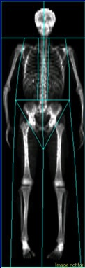
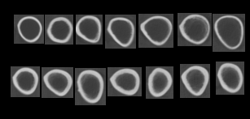
Physical inactivity and bone.
1
2
3
4
5
6
7
Inactive
1
2
3
4
5
6
7
Active
Notes:
The scans of the femur on the top are from 7 different people that have been almost completely inactive, whereas the 7 people below are people that have met the top tier of activity for over one year. There is a stark and obvious difference between the two sets of bones. Physical activity with adequate nutrition is clearly protective to bone, the lack of activity is devastating to it.

Slide 9
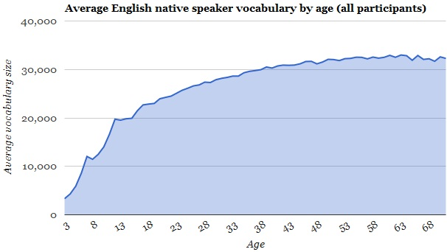
Literacy with Age: Vocabulary
Curriculum
Notes:
A measure of literacy is the number of words you know. For most people the words in our vocabulary increases nearly linearly from 3 years of age to 18. This can be attributed to our education system, and the parental belief in the importance of literacy for the well being of our children.

Slide 10
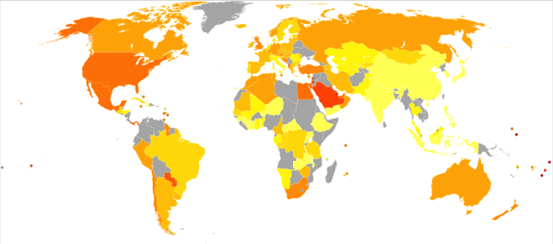
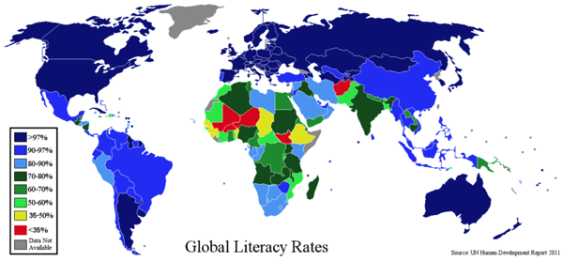
> 30
25-30
20-25
Global Obesity Rates
Notes:
Obesity maps – darker color indicates higher percentages of obesity. The literacy map on the bottom shows the very high levels of literacy in certain countries. Obesity is highest in so called developed countries where literacy rates are high. Literacy and numeracy have made us knowledgeable but not wise. If we were wise, we would follow the basic words “eat well and exercise regularly”.

Slide 11
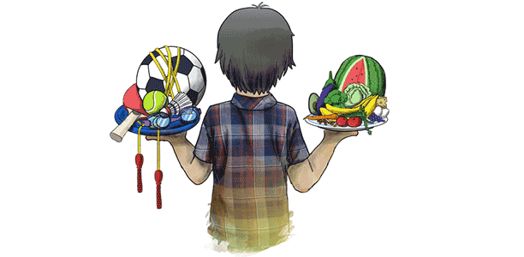
Eat Well and Exercise Regularly
Notes:
We have heard this for over 45 years, since 1968 we have had the media bombarding us with this message. Despite this promotion, we have actually headed in the wrong direction. Clearly a new paradigm is needed to make the change.

Slide 12
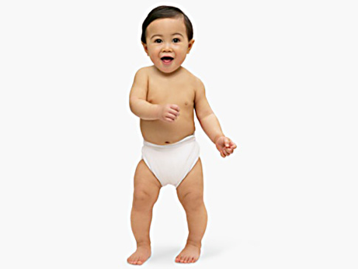
BORN TO MOVE
Better brain
Better muscle
Better bone
Better heart
Better body
Better social life
Better self-esteem
Low burden on health care and society
Better productivity
…
Notes:
The science is compelling. Regular lifelong movement helps every system of our body!! As Canadians we have clearer spoken through our inaction that “We want our health care, but we don’t want our health.” We need to break this cycle before it breaks us!

Slide 13
Notes:
This slide shows the steady linear climb in obesity in Canada. We need to stop this and likely reverse it back to 1970 levels! Despite any government of the day, we have not made a dent in the progression. The tobacco reduction slide indicates that we have made reductions BUT this required serious funds and serious legislation to make modest reduction. So please be aware this change will take time and likely resources – there are no quick fixes. We can project what the situation will look like in 2020-2025 using the Statistics Canada projections for the Canadian population. It is bleak! Using the Kruger report from British Columbia and for Manitoba on total costs for obesity, smoking and inactivity the burden we will all carry is very large indeed looking forward.

Slide 14
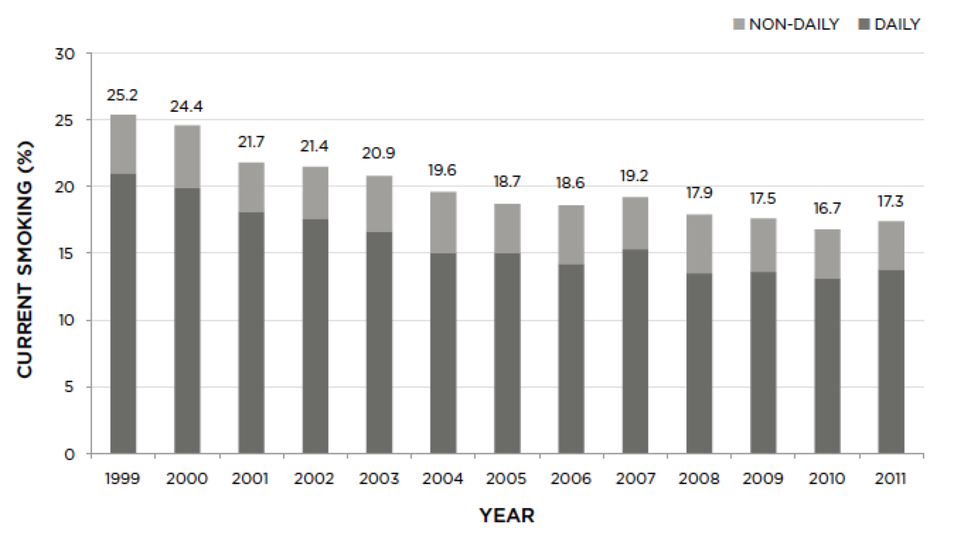
Notes:
This slide shows the steady linear climb in obesity in Canada. We need to stop this and likely reverse it back to 1970 levels! Despite any government of the day, we have not made a dent in the progression. The tobacco reduction slide indicates that we have made reductions BUT this required serious funds and serious legislation to make modest reduction. So please be aware this change will take time and likely resources – there are no quick fixes. We can project what the situation will look like in 2020-2025 using the Statistics Canada projections for the Canadian population. It is bleak! Using the Kruger report from British Columbia and for Manitoba on total costs for obesity, smoking and inactivity the burden we will all carry is very large indeed looking forward.

Slide 15
2010-2015
85%
Sedentary / Sédentaire
62% 27%
Overweight / Obese
Embonpoint / Obésité
2.5 Million
Diabetes / Diabète
50,733 TKR / ATG
2020-2025
90-95%
Sedentary / Sédentaire
30-32% Obese / Obésité
3.7+ Million
Diabetes / Diabète
68,200 TKR / ATG
Notes:
This slide shows the steady linear climb in obesity in Canada. We need to stop this and likely reverse it back to 1970 levels! Despite any government of the day, we have not made a dent in the progression. The tobacco reduction slide indicates that we have made reductions BUT this required serious funds and serious legislation to make modest reduction. So please be aware this change will take time and likely resources – there are no quick fixes. We can project what the situation will look like in 2020-2025 using the Statistics Canada projections for the Canadian population. It is bleak! Using the Kruger report from British Columbia and for Manitoba on total costs for obesity, smoking and inactivity the burden we will all carry is very large indeed looking forward.

Slide 16
Cost Dépense
2014
2025
5.8 $Billion/million
219 $Billion
3 $Billion/million
103 $Billion
Kruger Report 2014
Notes:
This slide shows the steady linear climb in obesity in Canada. We need to stop this and likely reverse it back to 1970 levels! Despite any government of the day, we have not made a dent in the progression. The tobacco reduction slide indicates that we have made reductions BUT this required serious funds and serious legislation to make modest reduction. So please be aware this change will take time and likely resources – there are no quick fixes. We can project what the situation will look like in 2020-2025 using the Statistics Canada projections for the Canadian population. It is bleak! Using the Kruger report from British Columbia and for Manitoba on total costs for obesity, smoking and inactivity the burden we will all carry is very large indeed looking forward.

Slide 17
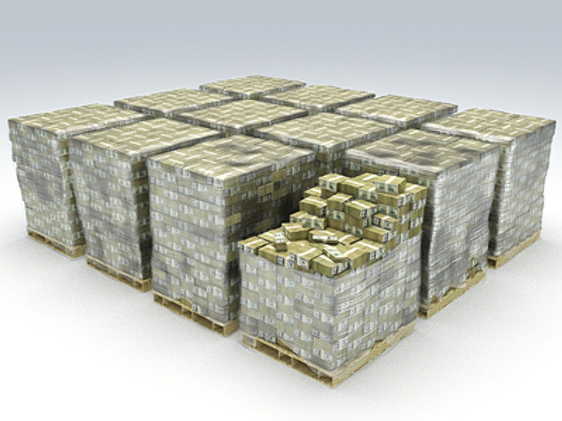
“UNBALANCED” BUDGETS
Health Care 5 billion $ per million people
Education & Literacy 2.3 billion $ per million people
Sport 40 million $ per million people
Tourism and Recreation 61 million $ per million people
Healthy Living 57 million $ per million people
Treatment
Prevention
Notes:
We spend lots of money on illness care. We spend lots on education and do well on literacy and numeracy. However, we spend very little on the sectors that could act to provide primary and secondary prevention of inactivity and obesity (namely sport, recreation and physical education). We will ultimately need money to rectify our collective problem.

Slide 18
The function of protecting and developing health must rank even above that of restoring it when impaired
Hippocrates

Slide 19
Despite all our efforts …
Committing armchair suicide
CBC
Broadcast Date: July 16, 1968
Increased postwar affluence means the nation eats more and walks less. These days, Canadians with bulging bellies are more likely to opt for a ride in the Chevy instead. Passive recreation like TV-watching is also a problem. A fitness expert in this 1968 television report says people are committing "armchair suicide." A man 33-pounds overweight is three times as likely to die suddenly of a heart attack. As a result, men begin lifting weights at the gym and housewives bounce along to TV exercise programs.
Committing armchair suicide
Broadcast Date: October 17, 2014
Increased postwar debt means the nation eats more and walks less. These days, Canadians with bulging bellies are more likely to opt for a ride in the VW instead. Passive recreation like screen time TV-watching is also a problem. A fitness expert in this 2014 1968 television report says people are committing "armchair suicide." A man 47-pounds overweight is five times as likely to die suddenly of a heart attack. As a result, men begin lifting weights at the gym and housewives head to hot yoga TV & Good Life.
Notes:
A good example of the our promotional efforts failing to address the insidious deterioration of the lifestyles of Canadians.

Slide 20

Canada: a Spectator Society
Obesity and Olympic Performance
Obesity (>30 BMI)
Medals
Notes:
This data clearly shows that we our great spectators (lots of screen time), this is not to say that the Olympics causes the sedentary behavior – it is to say that Olympics does not induce active participation of the Canadian public. It may well inspire Olympians but not inspire the public to be active.

Slide 21

Littératie physique

Slide 22
What is it?
  PL for health and active participation
  PL for performance
  PL for prevention
  PL for rehabilitation
  PL for vocation

Slide 23












Notes:
Many groups have adopted this term and integrated it into their operations.

Slide 24

Physical literacy can be described as the motivation, confidence, physical competence, knowledge and understanding to value and take responsibility for engagement in physical activities for life.
Whitehead, M. 2014.

Slide 25

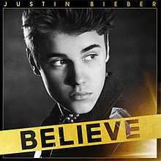
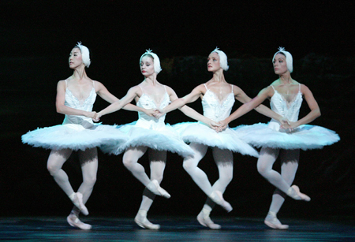

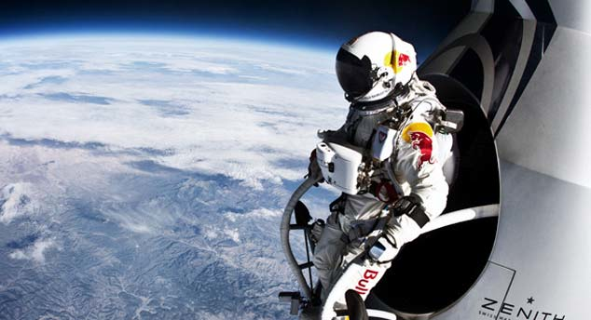
Literacy Model
“Skill Based Literacies”
Literacy
ABC
Words
Sentences
Numeracy
123
Fractions
Equations
Music
Do-re-mi
Scale
Score
Physical Literacy
Movement vocabulary
Sequences
Tasks

Slide 26
Literacy is the ability to identify, understand, interpret, create, communicate, compute and use printed and written materials associated with varying contexts.
Physical literacy can be described as the motivation, confidence, physical competence, knowledge and understanding to value and take responsibility for engagement in physical activities for life.
is the ability to read and write
competence to move
is the ability to use vocabulary to participate in society
is the ability to use movement vocabulary to participate in activity
Notes:
UNESCO’s def’n of literacy; high hopes of what literacy would do for society; IPLA’s intnl def’n
Standard dictionary def’n
Short form of standard dictionary def’n; their parallels
Participation: recreation, vocation, sport, performance arts, etc

Slide 27
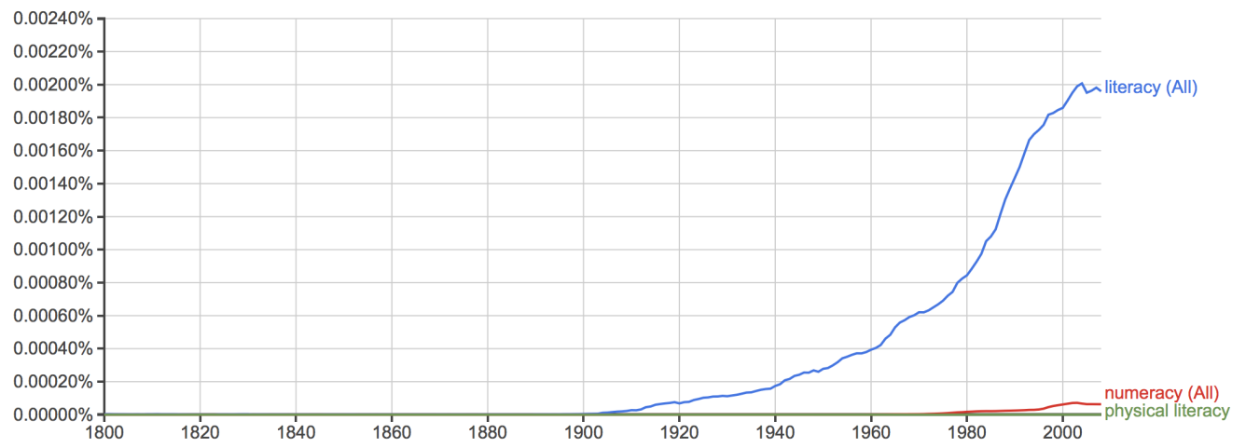
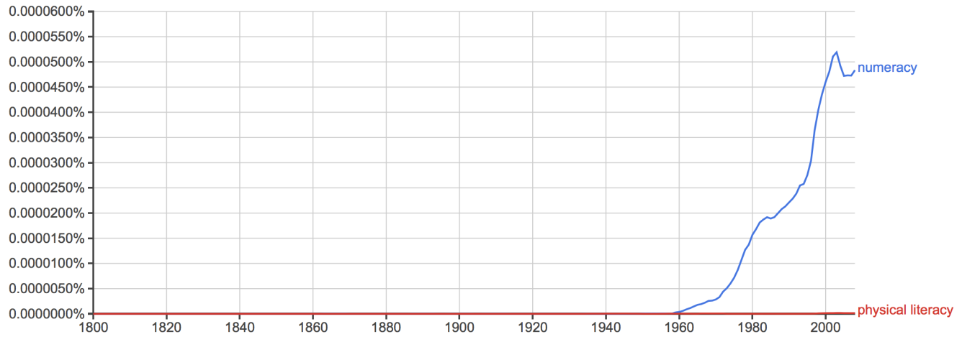
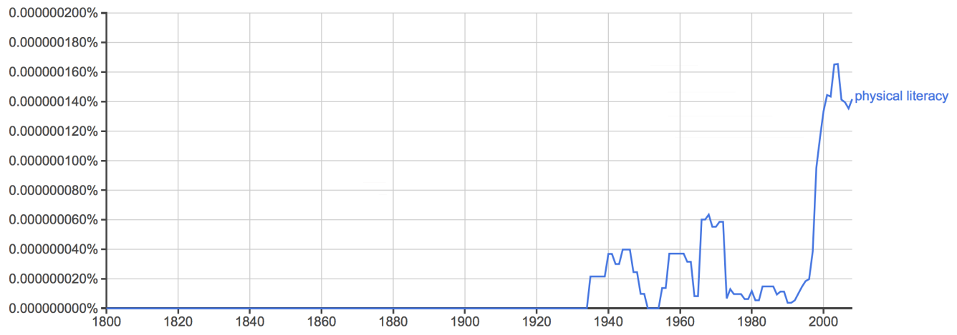
Literacy Campaigns: Word Usage 1800-2008
Literacy
We must prepare for physical literacy as well as for mental literacy. A physically fit America becomes more necessary with modern mechanical inventions.
1930
1910
Numeracy
Educators now say that the public schools must train for physical literacy, as well as mental literacy. There is much physical illiteracy in America.
1935
1960
Physical Literacy
Games, climbing, walking, dancing and manual occupations such as carpentry, building and so on, all conduce to physical literacy: that is to a disciplined command over the body. The same is true of literacy of the ear. 1937
1930
1992
Notes:
What do the %s correspond to? And I thought 1968 is when PL was first brought about. Why is there a big dip at 1980 ish after the rise and dip with 1960-1980?
The previous slide illustrates two points.
We are in the early years of the physical literacy campaign.
The physical literacy campaign started in 1930, see some selected, and I find impressive, quotations.
The term, physical literacy, did not take off till 1992.

Slide 28
Aligning Physical Literacy with Literacy
Movement Vocabulary
  An individuals repertoire of movement skills (or sequence of skills)
Movement Fluency
  The ability to execute a component of movement vocabulary with expertise.
Physical Proficiency
  The ability to select and proficiently execute movement vocabulary suitable to an environment or setting.
Physical Literacy
  Physical literacy is the ability to demonstrate physical proficiencies in multiple environments.

Slide 29
Physical Literacy
Educational Context
PHE Canada
Individuals who are physically literate move with competence and confidence in a wide variety of physical activities in multiple environments that benefit the healthy development of the whole person.
Physically literate individuals consistently develop the motivation and ability to understand, communicate, apply, and analyze different forms of movement.
They are able to demonstrate a variety of movements confidently, competently, creatively and strategically across a wide range of health-related physical activities.
These skills enable individuals to make healthy, active choices that are both beneficial to and respectful of their whole self, others, and their environment.

Slide 30
Physical Literacy
Sports and Activity Context
Canadian Sport For Life
Having the skills,
confidence and
motivation to enjoy a
variety of sports and
physical activities.

Slide 31
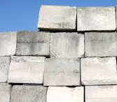
FMS
Movement Vocabulary
Awareness Selection Sequencing Modification
Diversity Environments (Physical and Social)
Physical Literacy
Comprehension Confidence Motivation
Free Play
+
Creativity
Motor Competence
Error
Reduction
Motor control errors
Selection error
Bilateral asymmetry
Participation
Activity
Durability
Physicalliteracy.ca
Fitness

Slide 32
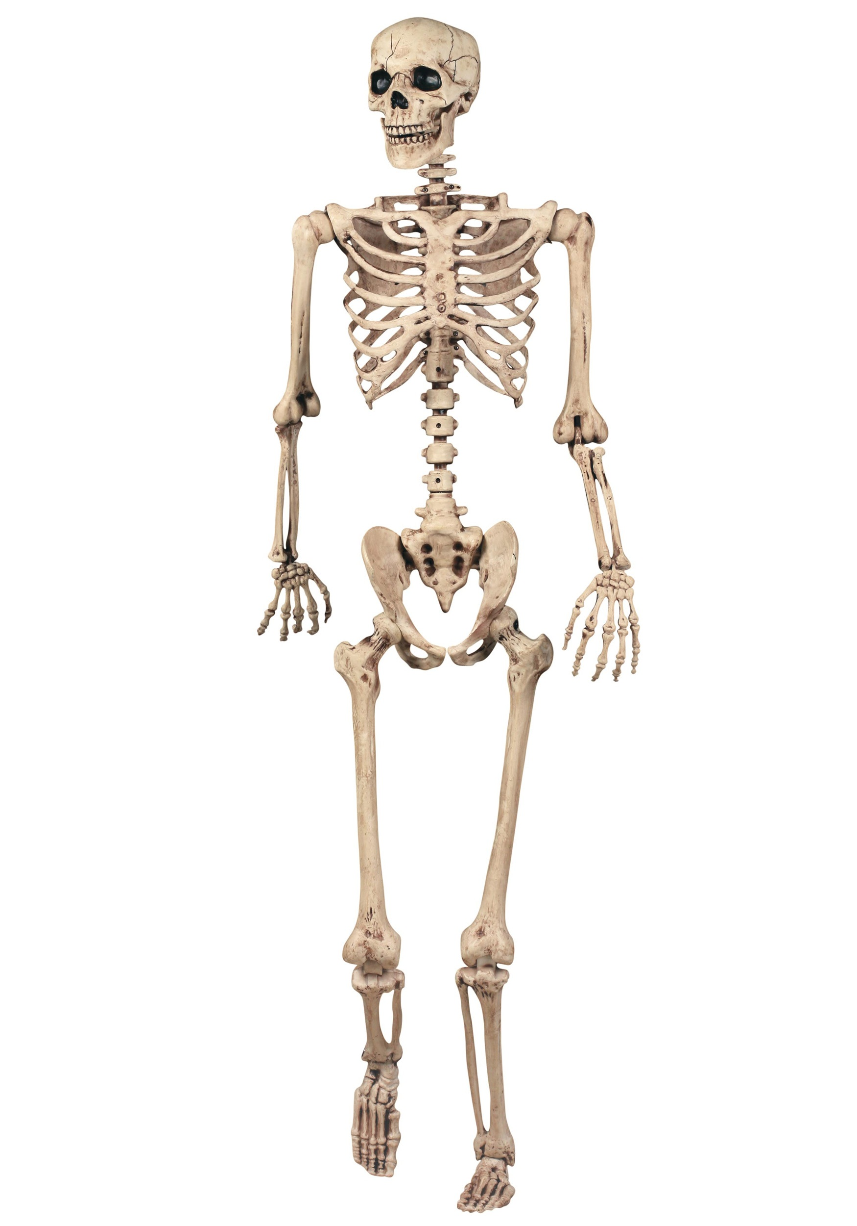
The CORE of Physical Literacy
1. Movement Vocabulary
2. Motor Competence

Slide 33

The Gateway to active participation.
A journey not a destination.

Slide 34
Physical Literacy
Across the Lifespan & Sectors
Leisure: Recreation & Sport
    Performance Excellence & Participation
Performance Arts
    Circus, dance
Vocational
    Firefighter, armed services, dry waller, iron worker, underwater welder, any vocation with physicality
Activities of Daily Living
    Garden, paint, hammer, walk on slippery surfaces, etc
Injury Prevention
    Lift, carry, transfer, lower – back injury – WCB
    Falls, stumble recovery, landing – fracture
    ACL: Female to Male ratio is 6:1, physical literacy related!

Slide 35
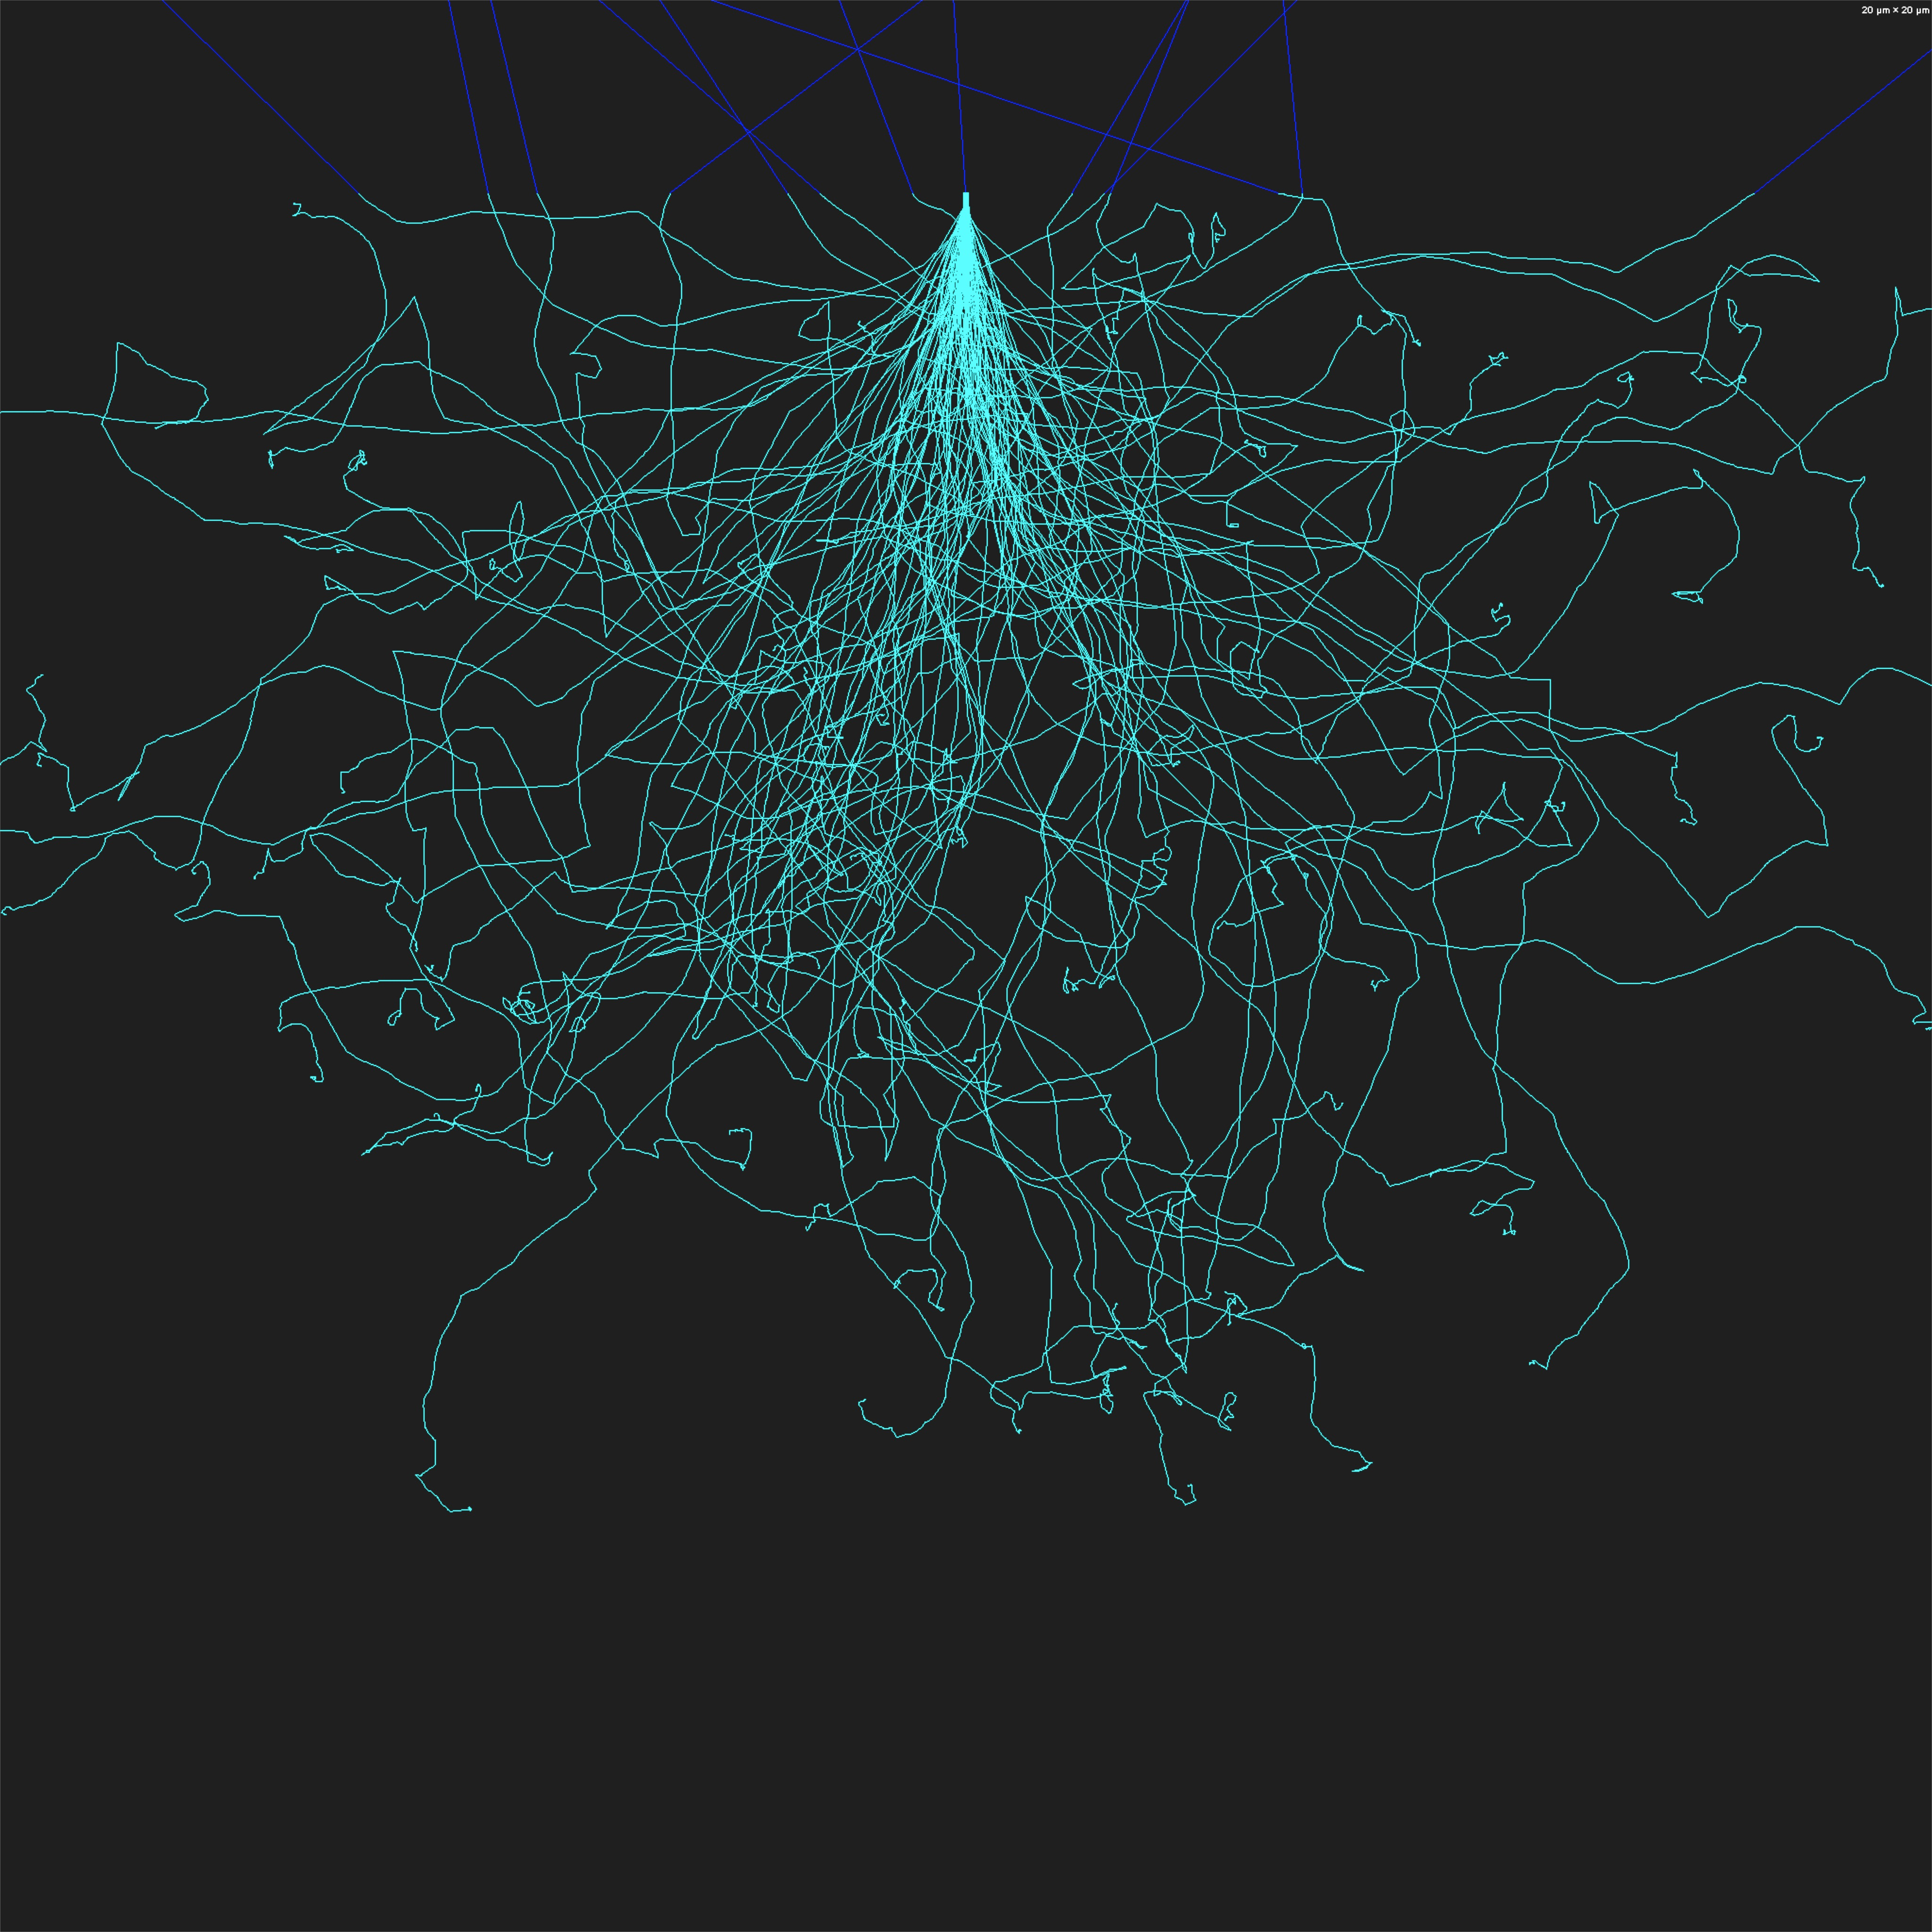
The Physical Literacy Journey
Equipping for the Journey
&
Managing Trajectories
Birth
Birth

Slide 36
Quality
Physical Literacy
Experience
Social
Psychological
Physiological
Biomechanics
Performance
Nutrition
Outcome
Eudemonia “flourishing”
Meaningful Participation
Recreation
Sport
Vocation
Performance Arts
At School
Physical Education
Rehabilitation
Medicine
Physical and Mental Health
Justice
Employment
…

Slide 37

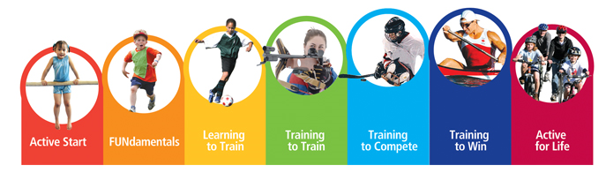

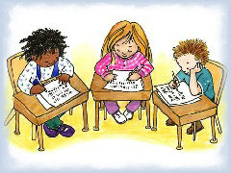
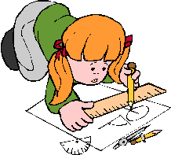

In & At
School
Recreation
Performance Arts
Sport, Coaching, Ex Pro
Health
Seamless integration for
PL trajectory management
No child
left behind
Notes:
Physical literacy is delivered through various curricular paths Recreation, sport, exercise professionals, coaching, and schools form the foundation of delivery of PL. Seamless integration has not been achieved.

Slide 38
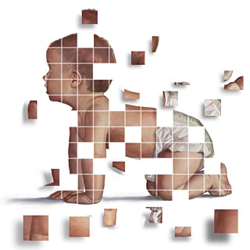
PL Enriched Environments
Building Physically Literate Children
Time and Accountability
in the hands of Caring & Trained Adults
TACT

Slide 39
Physical literacy is crucial to the acquisition, by every child, youth, and adult of essential life skills which is an indispensable means for active participation in the societies and economies of the twenty first century.
Physical
active
Adapted from UNESCO
Notes:
This is UNESCO’s statement about the importance of literacy worldwide! It was adapted to physical literacy. There can be no doubt that the need for physical literacy matches that of literacy and numeracy in the so called “developed countries” where we have traded our physical literacy for literacy and numeracy.

Slide 40
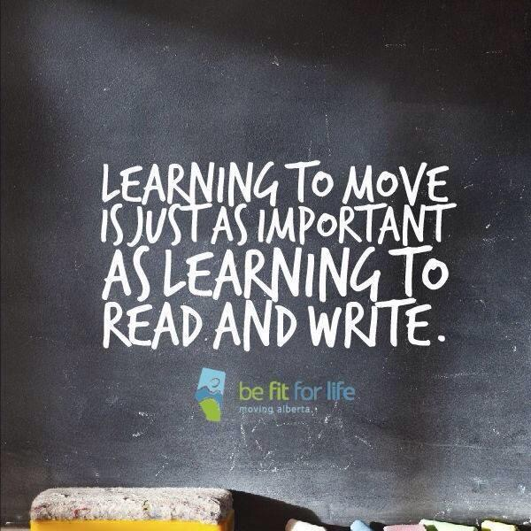

Literacy
Physical
Literacy
Numeracy

Slide 41
The Physical Literacy Lens
PL Assessment is more than just physical; PL Assessment includes
  Physical
    Environments
    Diversity
    Competence
  Psychological
    Cognitive
    Self-efficacy
    Worry
    Confidence
    etc
  Social
    Participation
Objective Assessment
  Motor Competence
  Confidence
  Comprehension of terms
  Quantity of Acquired Movement Vocabulary
Perceptions
  Self
  Parent
  PE/Coach/instructor
Participation
  Type
  Environment

Slide 42

www.physicalliteracy.ca/PLAY

Slide 43
PLAY Tools
PLAY FUN – assessment of motor competence, movement vocabulary, confidence, comprehension
PLAY Basic – 5 task version of PLAY FUN
PLAY Coach – coach/PE/PT/AT assessment of a child
PLAY Parent – parental assessment of a child
PLAY Self - child’s self assessment
PLAY Inventory - inventory of activities- participation
PLAY Creativity – divergent test of movement creativity
Each Tool has:
  Workbook
  Form
  Scoresheet
  Tracking Sheet
  Calls-to-action
Physicalliteracy.ca
Notes:
Only the PLAY Fun tool requires special training. These tools are designed to align with the PHE Canada Passport for Life tool described next.

Slide 44
PLAY Tools
Reliable Valid Meaningful Sensitive
PLAY FUN – Objective PL Assessment
  0.68 – 0.92 TRT
  0.78 – 0.87 IRT
  0.82 TGMD2- concurrent validity
PLAY INVENTORY – participation inventory
  0.55 – 0.78, TRT, age
PLAY SELF – self assessment of PL
  0.63 – 0.88, TRT, age
PLAY COACH– surrogate recall assessment of PL
  0.84 – 0.91, TRT, skill
PLAY PARENT – parental assessment of child’s PL
  0.65 – 0.81, TRT, sex of parent

Slide 45
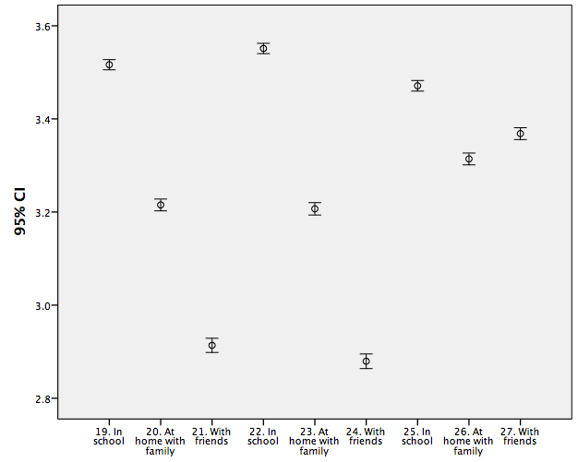
Importance of Skill Based Literacies
VERY NB
SOMEWHAT NB
Read/Write
Math
Movement

Slide 46
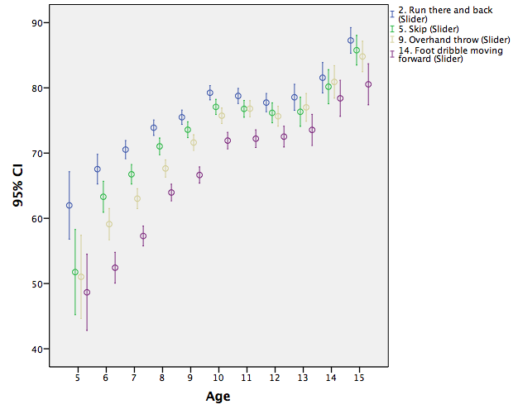

Slide 47
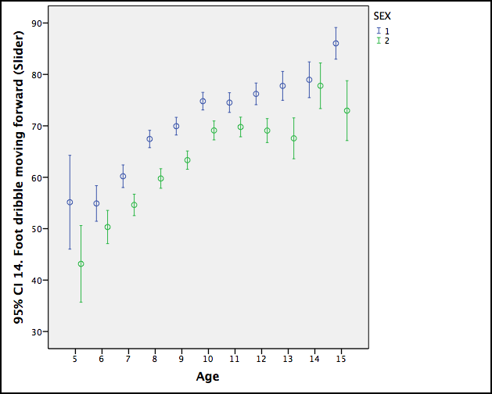
Dribble ball with foot

Slide 48
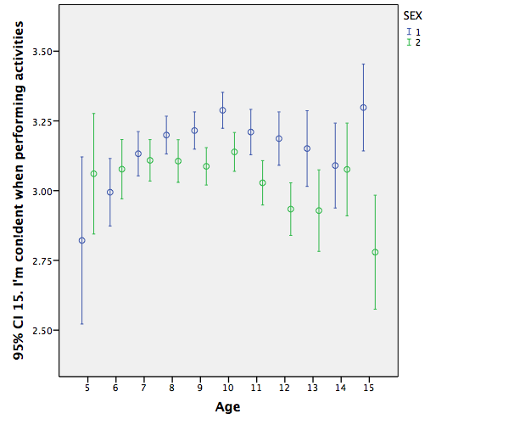
Confidence: Age and Sex

Slide 49
The Cycle
Confidence
Motivation
Competence

Slide 50
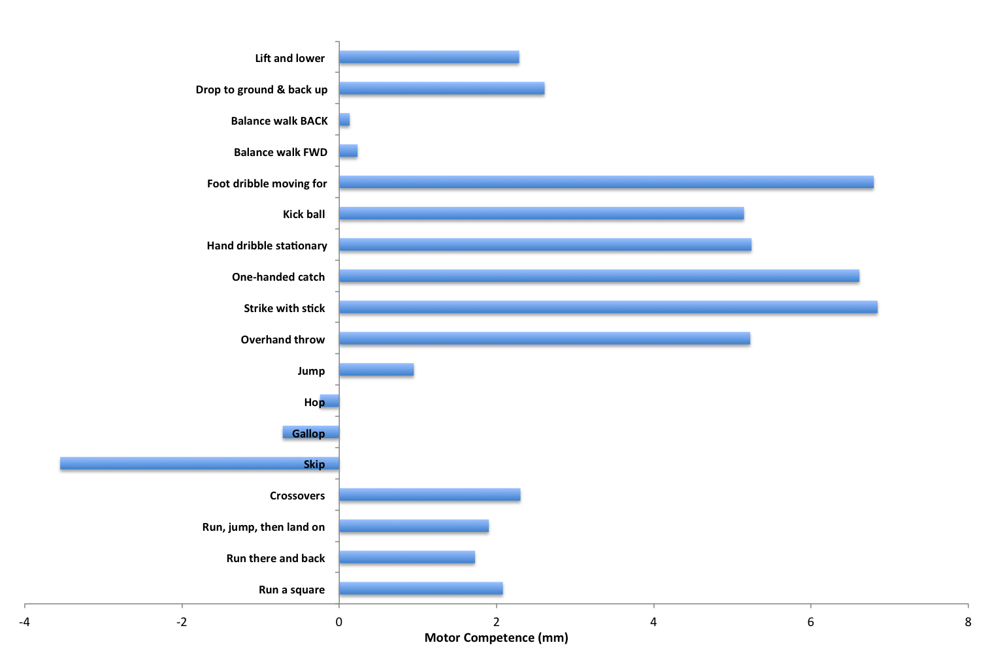
Motor Competence: M & F
Female > Male
Male > Female

Slide 51
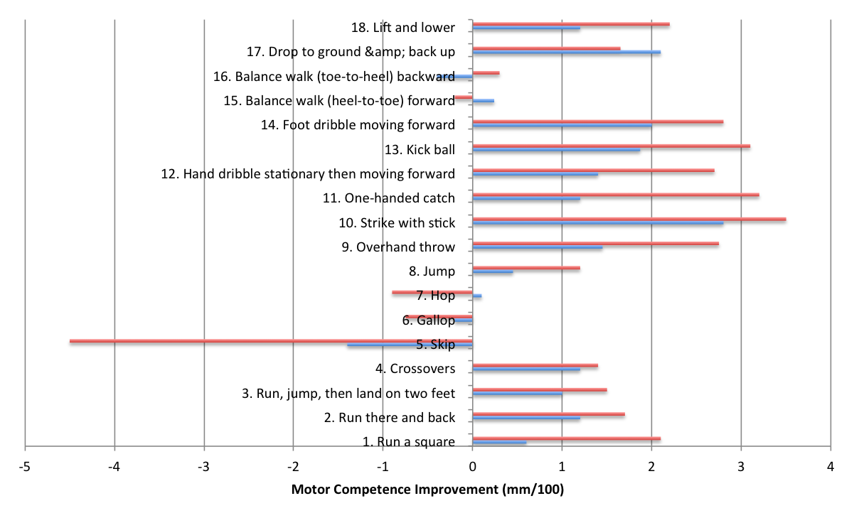
Sex Based Differences in Competence (QPLE reduces gender effect)

Slide 52
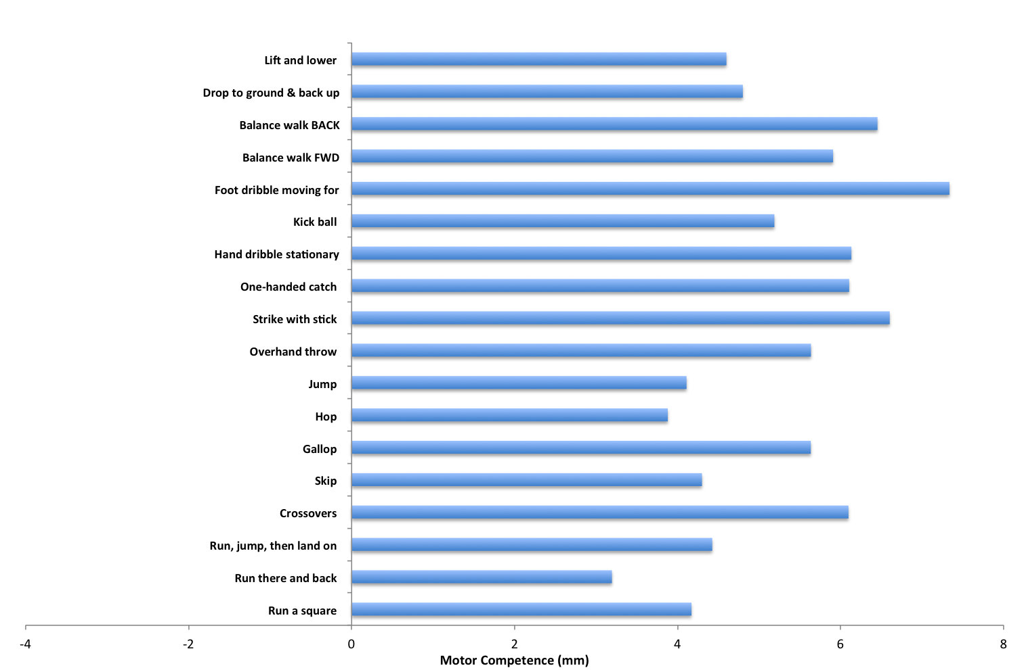
Motor Competence: ΔTIME

Slide 53
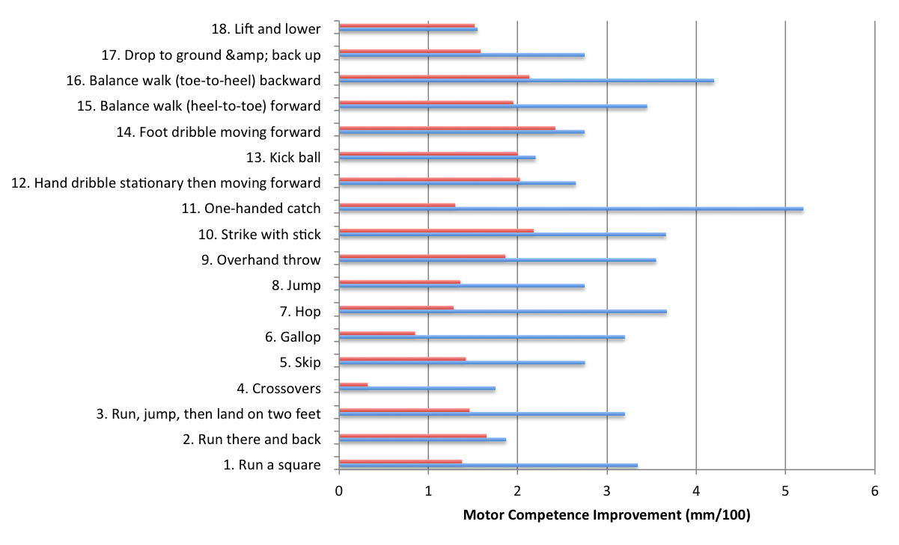
Motor Competence Over Time
Quality PL Enriched PE vs Standard PE

Slide 54
Intervention
RJT lesson plans in PE class
10 weeks, 2X per week
PE: 4 control schools
PE/RJT: 4 intervention schools

Slide 55
PE protects dysfunctional self-representation of PA
through understanding of movement and physical literacy and fitness

Slide 56
Perception of Competence
 | Hi PL (n=44) |  | Lo PL (n=57)
Physical Self-Description Questionnaire (PSDQ) (maximum of 6)
Health | 4.93 (0.68) | >NS | 4.60 (1.03)
Coordination | 4.82 (0.81) | >** | 4.08 (0.94)
Physical activity | 5.37 (0.69) | >** | 4.14 (1.32)
Body fat | 5.37 (0.83) | >** | 4.32 (1.53)
Sports competence | 4.93 (0.80) | >** | 3.73 (1.33)
GP self-concept | 5.24 (0.71) | >** | 4.10 (1.20)
Appearance | 4.83 (0.78) | >* | 4.28 (0.94)
Strength | 4.66 (0.99) | >** | 3.74 (1.13)
Flexibility | 4.21 (1.13) | >NS | 3.81 (1.20)
Endurance/fitness | 4.89 (0.98) | >** | 3.57 (1.27)
Global self-esteem | 5.44 (0.46) | >** | 4.87 (0.81)

Slide 57
Predictors of Motor Competence
Regression
  Dependent: Overall Physical Literacy
  Independents: ALL PLAY SELF QUESTIONS
  R=0.248, p<0.001
Four Predictors (of 28)
    In the gym
    I understand the words that coaches and Phys Ed teachers use
    Outdoors
    I worry about trying a new sport or activity
Participation
Comprehension
Participation
Worry

Slide 58
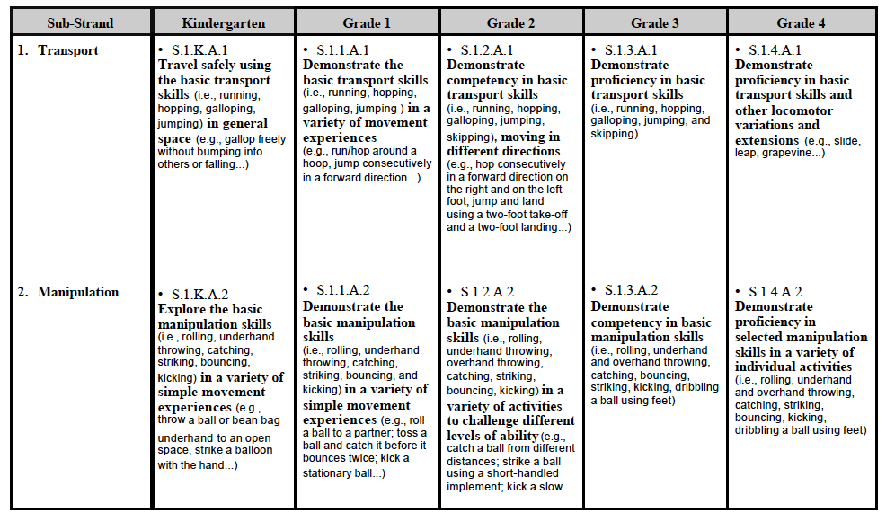
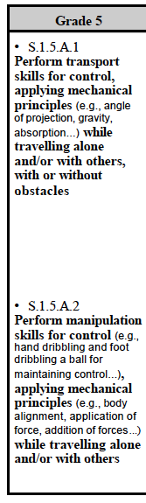
MB PE Curriculum Expectations
Grades K-4: basic motor skill acquisition, with knowledge of why, what, and how
Grades 5-8: functional use of the skill while participating in a variety of activities in different environments/settings
Notes:
What’s shown in PLAY tools to be acquired

Slide 59
PLAY Tools -Movement Skill | Grade 4 PE | Grade 5 PE
Run a square | X | X
Run there and back | X | X
Run, jump, land on 2 feet | Jump & land 2 feet | X
Crossovers | X | X
Skip | X | X
Gallop | X | X
Hop | X | X
Jump | X | X
Overhand throw | X | X
Strike with stick | X | X
One-handed catch | catching | X
Hand dribble stationary & moving forward |  | X
Kick ball | X | X
Foot dribble moving forward | Dribbling using feet | X
Balance walk (heel to toe) forward
Balance walk backward
Drop to ground & back up
Lift and lower
Notes:
Animate so grade 4 and 5 come in at diff’t times

Slide 60
PREVENTION & REHABILITATION

Slide 61

Physicalliteracy.ca

Slide 62
MOTOR CONTROL ERRORS
ERROR 1
BRAIN FAILS TO ASK THE MUSCLE TO DO
BRAIN TRAINING
REPETITION BASED LEARNING WITH KNOWLEDGE OF RESULTS
PERTURBATION MANAGEMENT
ERROR 2
MUSCLE FAILS GIVEN APPROPRIATE NEURAL INPUT
MUSCLE TRAINING
CLASSIC STRENGTH AND ENDURANCE TRAINING
Selection & Sequencing ERROR

Slide 63
PL Prevention Study
An ACL injury prevention program for provincial and Canada games team level soccer players (ages 12 to 18) was implemented.
The ACL injury prevention drills were embedded into "conditioning" sessions integrated into practice by coaches. The sessions involved dynamic warm-up, ladder drills, pylon drills, sprints, single legged exercises, as well as core and gluteus medius exercises motion control exercises.
The basis of the injury prevention program was repetition-based learning of primary forms of pivoting/cutting movements observed in soccer competitions. The goals of the ACL injury prevention drills were to maximize proficiency in cutting maneuvers, and minimize right to left asymmetry.

Slide 64
PL Prevention Study
There was a high level of adoption (100%, 10 teams) and compliance (1-3x/week use) by coaches. Over 160 participants were engaged in the prevention program for two years. 120 control (no intervention) for two years.
All athletes were evaluated (every 2-3 months) for CV fitness, 40 m sprint, core, and lower body power. Significant improvement in all fitness and performance measures.
Drill based proficiency assessment revealed substantial right to left asymmetry in females, as well as lower overall proficiency than males. Drills improved proficiency for box step cutting maneuver in both males and females, and dramatically reduced asymmetry in females.
The ACL injury rates were less than half (2.1%) of the rates (7.5%) in new cohort without the ACL prevention, and lower than published rates (5%). (P < 0.05)

Slide 65
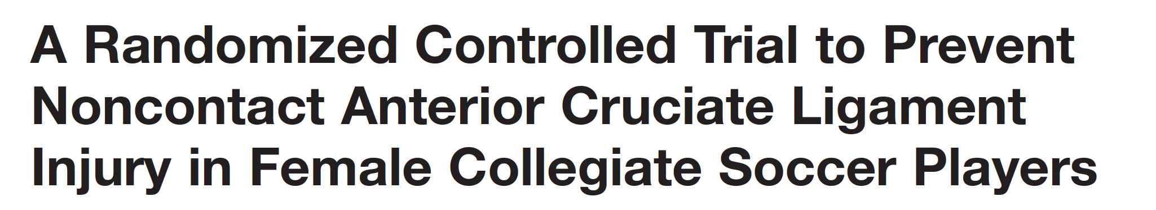
Sixty-one teams with 1435 athletes completed the study (852 control athletes; 583 intervention).
The overall anterior cruciate ligament injury rate among intervention athletes was 1.7 times less than in control athletes (0.199 vs 0.340; P = .198; 41% decrease). Noncontact anterior cruciate ligament injury rate among intervention athletes was 3.3 times less than in control athletes (0.057 vs 0.189; P = .066; 70% decrease).
No anterior cruciate ligament injuries occurred among intervention athletes during practice versus 6 among control athletes (P = .014). Game-related noncontact anterior cruciate ligament injury rates in intervention athletes were reduced by more than half (0.233 vs 0.564; P = .218).
Intervention athletes with a history of anterior cruciate ligament injury were significantly less likely to suffer another anterior cruciate ligament injury compared with control athletes with a similar history (P = .046 for noncontact injuries).
They use flexibility, agility and strength training drills . Unknown which element was effective.

Slide 66
Matched
Control
PL
Pre
PL
5-21 days
PL
1-2 years

Slide 67
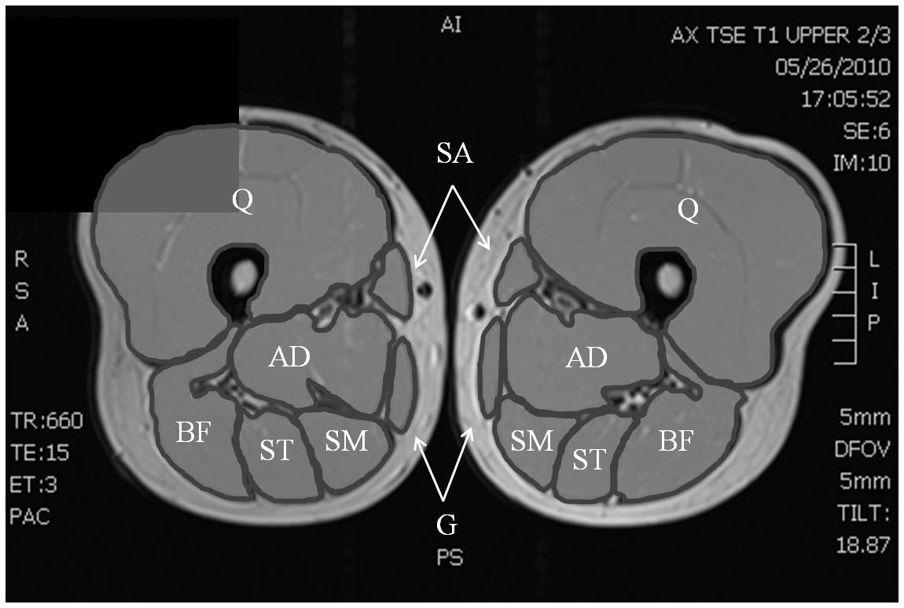
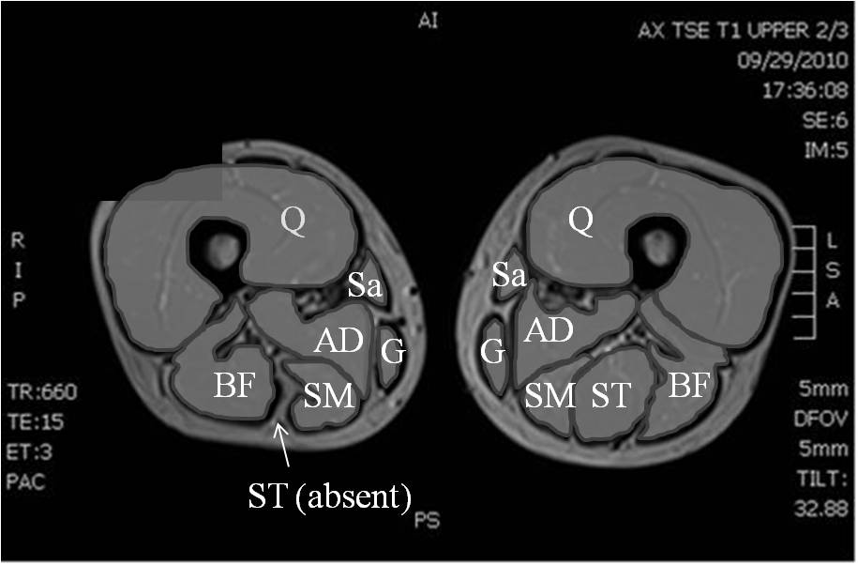
ST
41.5
G
65.5

Slide 68
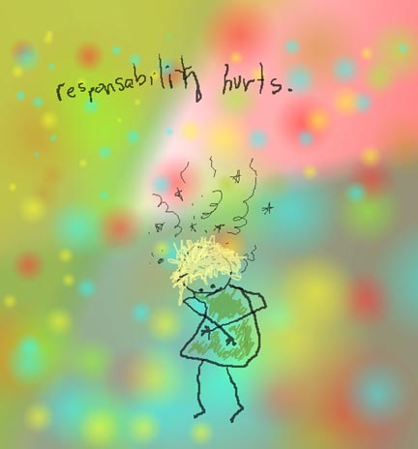
Distributed Responsibility and Child Health
I promise
to rise.
Notes:
68

Slide 69
PL Rehab Study
NBA NFL : 20-30 % failure to return, 40-60% player decline statistics
A four year, 42 person case control series was performed using a physical literacy rehabilitation approach for performance athletes.
The repertoire of movement skills/sequences involved in each sport was performed by observational analysis, and delineated by player position. This repertoire guided movement skill progression along with targets for fitness and performance measures.
Inclusion required documentation of performance and fitness measures prior to ACL rupture, high performance competition level, and age 15 and above.

Slide 70
PL Rehab Study
Participants engaged in an average of 7 hours/week of training with 11-14 sessions per week by day 8 post-op.
40 of 42 participants acquired or exceeded pre-rupture fitness and performance measures at 7 months.
41/42 demonstrated high level proficiency in sport and position specific movement skills at 6 months.
41/42 were compliant with the protocol and maintained consistent training to 1 year post surgery.
42/42 returned to play between 6 and 7 months post-surgery at a level equal or greater than their pre-rupture competition level.
One ACL rupture of the contralateral limb occurred at 1.8 years post surgery due to a player-to-player contact, and one ACL re-rupture occurred during a pivoting kick. The non-contact injury occurred in the participant that was non-compliant.
This physical literacy based rehabilitation progression and return to play model was successful, and revealed improved player return statistics and dramatically lower re-rupture rates (3% versus 7-17%).

Slide 71
Standard
Physical
Literacy
Pre
2 year

