Slide 1
Food Security
Feeding Saskatchewan and the World

Slide 2
Who Am I?
Bulleted list with info about yourself.
Name
Job role
Personal connections or connections to agriculture
Educational background
Why are you excited about this presentation today.
Insert a photo of yourself, or logo for the business you are representing.
Notes:
Introduce yourself and the program you are representing. Take a minute to share the reason you are inspired to get involved with FFF or AITC.
Share your connection with Agriculture and what it means to you.

Slide 3
Agriculture
What does ‘Agriculture’ mean?
The 4 F’s of Agriculture
Food
Feed
Fiber
Fuel
Notes:
Give a brief description of agriculture. A definition we frequently use is ‘Growing something like crops or producing something, like animals, that we can use to help meet our needs. Agriculture reaches far beyond the farm and includes interests such as science, engineering, banking, marketing’. We often categorize the needs met through agriculture as ‘the 4 Fs’ of agriculture. People eat food, animals eat feed, we use fibre to create materials for goods such as cotton for clothing or flax for linen paper used for money, some types of seeds or the non-edible portions on plants can be used to create fuels such as ethanol. Have students give examples of each. A fifth ‘F’ that is sometimes discussed is Pharmaceuticals. Items that have a medicinal application may be produced though agriculture.

Slide 4
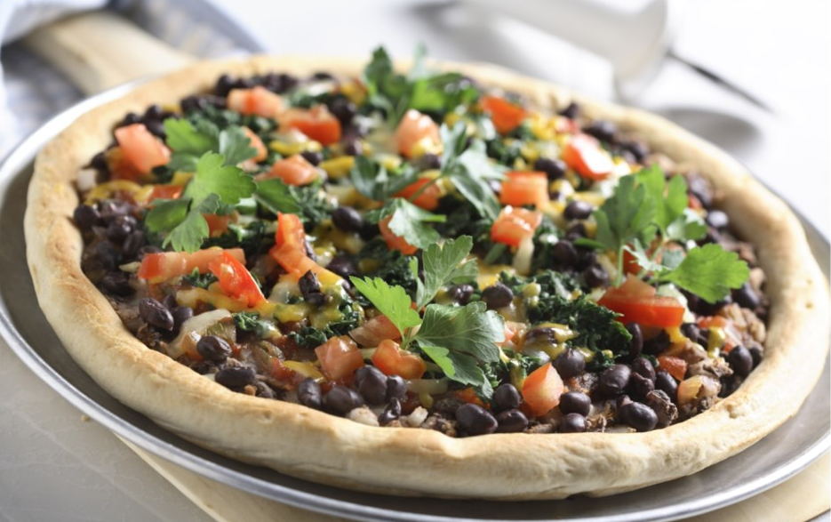
Agriculture
Food
Notes:
In our presentation we are going to focus on Food. If you have time, you can ask students to brainstorm some of their favorites and the ag origins. For example, tacos- shells are made from corn or wheat, beef for filling, cheese comes from dairy cows, lettuce and tomatoes can be grown outdoors in summer or in greenhouses in colder seasons.

Slide 5
Food Security
Food Security exists when all people, at all times, have physical and economic access to sufficient safe and nutritious food that meets their dietary needs and food preferences for an active and healthy life.
-1996 World Food Summit (FAO, 2008)
Notes:
This is the definition given by the United Nations World Health Organization. There is a lot of information packed into the statement.
All people means not just the wealthy or powerful have access to food
At All times means if you enough food occasionally but it is not the usual circumstance, you wouldn’t be considered food secure
Physical and Economical access means you can financially afford enough safe, nutritious food but that you also have means of acquiring it.
Safe food means that you can be confident that the food hasn’t been contaminated by pathogens, chemicals, physical objects etc. and that eating it won’t negatively impact your health.
Nutritious food means that you will get the nutrients- the vitamins, minerals, carbohydrates, fats and proteins that your body needs
Dietary needs are all of the things that our bodies can’t produce, but we need them to live, so we have to get them through our diet. These are things like energy, amino acids, fatty acids, mineral and vitamins. The amounts and types each person needs depends on things like gender, size, age, level of activity, chronic disease, etc.
Food Preferences are the things we like to eat or things that align with our personal and religious beliefs. For example, access to protein through pork products is okay for some people, but not if you are Muslim or Jewish.
An active and healthy life requires enough energy and nutrients for people to grow, learn, play, heal etc. not just stay alive.
Any questions?

Slide 6
Food Security
Notes:
Knowing what food security means, is everyone on Earth food secure? Everyone in Canada? Everyone in Saskatchewan?

Slide 7
Reasons for Food Insecurity
Financial Access
Increased demand for food
Availability of arable land
Limited Technology
Safety Breech
Physical Access
Transportation
Storage
Geography
Conflict
Weather
Food Loss
Food Waste
Notes:
Ask for student input as you read out the headings.
Financial Access is a fancy way of saying that you don’t have enough money to buy the food that you need. This is a common barrier and often the most common in developed countries.
Physical Access refers to actually getting the food. Transportation can include getting the food from the farm to market or getting food from the market to the consumers. For example, poor roads in a rural area of a developing country may make it difficult for farmers to sell their crops. Living in a core neighborhood of a major city often means that groceries stores are far away. If you don’t have a car, you may need to walk, ride a bike, take the bus, hire a taxi or arrange a ride in order to get food. Storage is a challenge at the production level in some places. Harvested crops are usually stored in bins in Canada where they are protected from weather and pests, however, globally speaking, not all farmers have access to safe storage for their harvests. Grain stored outdoors is subject to weather, contamination, pests and ultimately reduced quality. Geography can be a factor in food security due increased cost and storage/transportation requirements. Northern or remote communities pay much more for their food and are vulnerable to shortages and access. Conflict poses a challenge when either transportation methods are blocked, or food is held by powerful parties in order to control the people. Weather may interfere with the ability to grow or transport food.
Increased demand for food- as population increases and the economies in developing countries improves, so does the demand for food, especially meat. Sometimes meat is produced on marginal land but sometimes good farm land is converted to pasture land for animals which can have ripple effects in supply.
Arable land is land that is suitable for growing crops- only about 3-5% of the Earth’s surface. It is being lost to urbanization and sometimes environmental factors.
The number of farms is shrinking so farmers have to be more efficient in order to produce enough food. Use of different technologies allow farmers to farm more land or improve their yields while decreasing inputs. Technologies include things like automated equipment, computerized processes, drone scouting and modified seed. Not all consumers believe that technology should have a role in food production so producers may be limited by market trends. Not all farmers have access to technology do to financial or geographic limitations.
A safety breech at any level- during production, shipping, storage or even at the home can cause food loss and may lead to insecurity. This can include physical, chemical or microbial contamination, improper handling conditions, etc.
Food Loss refers to any food that is lost in the supply chain between the producer and the market. This may be the result of pre-harvest problems, such as pest infestations, or problems in harvesting, handling, storage, packing or transportation. Some of the underlying causes of food loss include the inadequacy of infrastructure, markets, price mechanisms or even the lack of legal frameworks. Tomatoes crushed during transport because of improper packaging is one example of food loss.
Food Waste typically occurs at the consumer level and refers to the discarding or alternative (non-food) use of food that is otherwise safe and nutritious for human consumption. Food is wasted in many ways:
Fresh produce that deviates from what is considered optimal in terms of shape, size and color, for example is often removed from the supply chain during sorting operations.
Foods that are close to, at or beyond the “best-before” date are often discarded by retailers and consumers.
Large quantities of wholesome edible food are often unused or left over and discarded from household kitchens and eating establishments.
Less food and food waste would lead to more efficient land use and better water resource management with positive impacts on climate change and livelihoods.

Slide 8
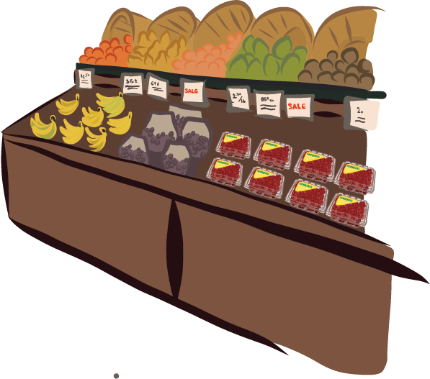
Barriers in Saskatchewan
Financial Access
Physical Access
Transportation
Geography
Weather
Others?
Others?
Notes:
Discuss how these barriers may look in Saskatchewan. Ask the students to comment on how the barriers differ between urban, rural and remote (far northern, island) communities.
Can the students identify additional barriers?
What could you do if you were food insecure?
Food Bank or soup kitchen (identify the difference)
Help from friends/family
Take on additional jobs to increase income

Slide 9
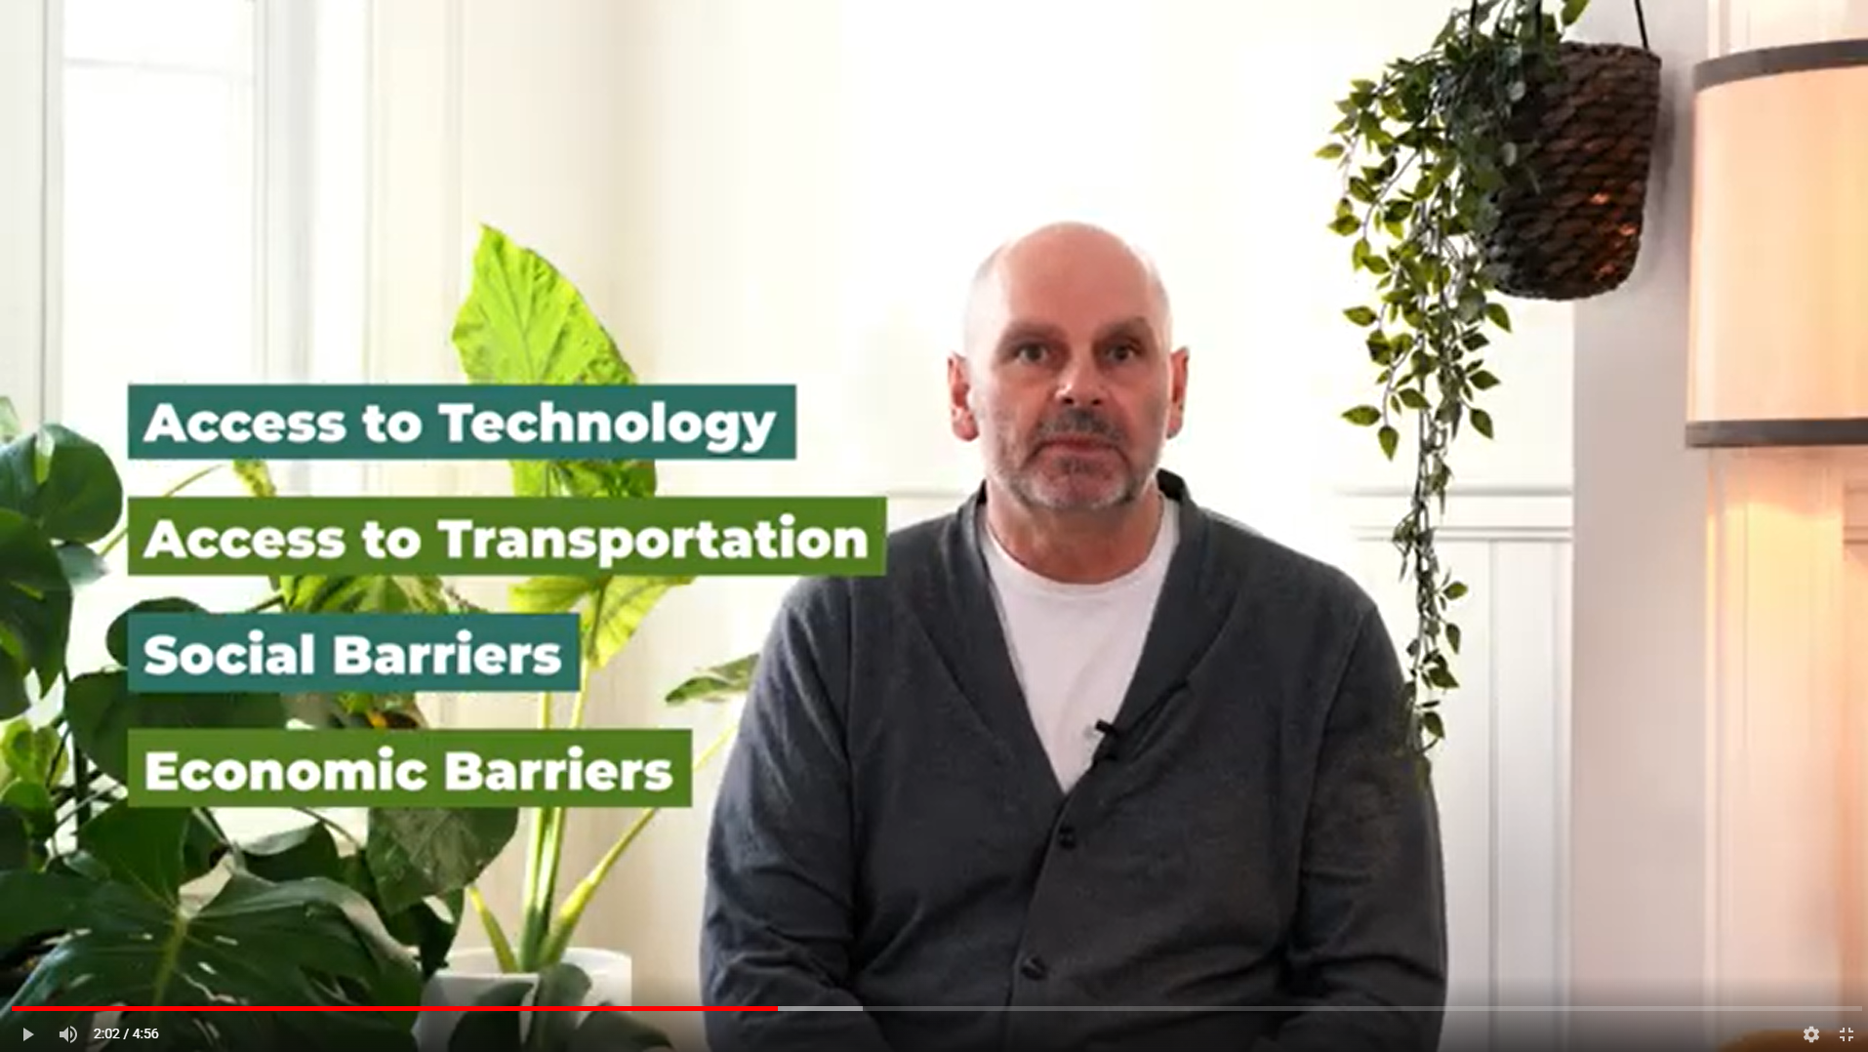
Barriers in Saskatchewan
Gord Androsoff, Executive Director of CHEP Good Food Inc describes food security challenges and impacts of COVID-19 on urban food security(Food Security and CHEP).
Notes:
This video connects to a Youtube video featuring Gord. Have students watch the video and hear directly from a local source about how COVID-19 and food security were linked. It also helps to highlight issues that were covered on the previous slide.
Helpful Hint: Have the video already opened in a web browser and switch to it during the presentation rather than relying solely on the hyperlink. If no internet access – the video is also included as a file in the USBs.
Link: https://www.youtube.com/watch?v=heSl-qtkmrw&ab_channel=AgricultureintheClassroomSK

Slide 10
Household Simulation
Break into eight groups.
Each group needs:
Budget Planner
Calculator
Dry Erase Marker
1 Context Card (given out at random by your teacher)
Introduce the groups (read your context cards)
10 minutes to complete the budget worksheet
Remember to multiply expenses by family members (I.e. Food x4 or x3).
Notes:
“We’re going to play a game that hopefully helps us to see how food fits into a household budget and what kinds of challenges families may face.”
Break class into 8 groups. Each group will need a Context Card, a budget planning sheet and a calculator.
Have the groups introduce themselves by reading their card to the class.
You can choose to use a timer, have the student work for 10 minutes to complete the budget work sheet.

Slide 11
Simulation Step 2
Each group needs:
Twist of Fate Card (given out at random by your teacher)
5 minutes to adjust the budget worksheet
Discussion (or use worksheet and compare with another group)
Notes:
Ask the students to share their challenges, priorities, thing they chose to cut, if they chose fruits/vegetables and how important food is in their budget.
Pass out the ‘Twist of Fate’ cards, ask each group to discuss the scenario and spend a few minutes adjusting their budget.
Facilitate a group discussion: What did students cut? Why? Did students opt for any creative solutions? Was it a challenge to work within the budget?
Ask students to relate their findings from the activity to the lives of people in their immediate community, the province and the world.

Slide 12
Class Discussion
Group sharing
Each group should share their budget and their experience working within it
Was it easy to budget for your family?
What were some of the budget challenges?
What were some budget cuts you had to make?
How did that make you feel?
How important was food in your budget?
Were you able to feed your family the way you wanted to?
How do these decisions look in:
Your community
Our province
The world
What can you do to make a difference in food security?

Slide 13
What Can We Do?
Use a budget, make financially conscious choices
Reduce Wasted Food (also reduces wasted money!)
Meal Plan
Use Leftovers
Share larger portions
Donate to local food banks, soup kitchens, or charities
Notes:
Ask the students to brainstorm some ways to help prevent food insecurity.
Using a budget helps to forecast expenses and prioritize purchases so that there is money reserved for food. Making choices such as house brand over name brand may help to increase the amount of money available.
Making a weekly meal plan, sticking to a grocery list, using up leftovers for lunches or buying in bulk and sharing are ways to reduce wasted food and help the food purchased stretch a little further.
Donating food or money to the local food bank or soup kitchen can help neighbours when they are in need.

Slide 14
Questions? Ideas?
Notes:
Ask students if they have any questions or ideas they’d like to share.
Thank the class for their participation.
Remember to record the number of students that participated and to share the teacher evaluation survey.

