Slide 1
Health Sciences 20
1.1 - History of Medicine

Slide 2
History of Health Care
Why is this important?
Did you know some treatments today were also used in ancient times?
People used herbs and plants as both food and medicine
A common example of this is morphine
Let’s see how ancient discoveries have shaped the health care you receive today.

Slide 3
Ancient Times
In more primitive times, the common belief was that disease and illness were caused by evil spirits and demons.
Religion played an important role in health care, as sickness was seen as a punishment.
Religious rites were used to eliminate evil spirits and restore health.
The human body was a mystery as most religions did not allow dissection of the body.

Slide 4
Ancient Cultures and Medicine
Egyptians
The first people to record health records – but most people could not read.
Chinese
Held a strong belief in holistic health methods – which stress treating the entire patient – mind, body, and soul.
Greeks
Hippocrates, the “Father of Medicine,” helped prove that disease is caused by natural causes.
The Greeks were the first to stress that a good diet and cleanliness would help prevent disease.

Slide 5
The Romans
The Romans realized that disease was connected to filth, bad water, and poor sanitation.
They built sewers for waste, and aqueducts to deliver clean water.
They created laws to keep streets clean and eliminate garbage.
The first hospitals were also established.

Slide 6
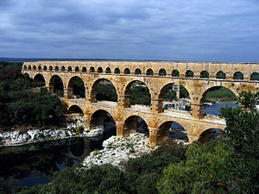
Aqueducts

Slide 7
The Dark Ages (400 – 800 AD)
After the fall of the Roman empire, the study of medicine stopped.
Emphasis was placed on saving the soul – the study of medicine was illegal
Prayer and divine intervention were used to treat illness and disease
Average life span was 20 to 30 years

Slide 8
Middle Ages (800 – 1400 AD)
The study of medicine was allowed again
Monks found and translated the writings of Greek and Roman physicians
Medical universities were created in the 9th century to train doctors how to use this knowledge
Average life span was 20 to 35 years

Slide 9
The Black Death
In the 1300s, a major epidemic of bubonic plague (the black death) killed 75% of the population
The disease was carried by rats and is cured today by a simple antibiotic

Slide 10
Renaissance (1350 – 1650 AD)
This time is known as the “rebirth of science of medicine.”
The major source of information was a result of accepting and allowing human dissection
Doctors could now view body organs and see the connection between different systems.
Michelangelo and Leonardo da Vinci were able to draw the body accurately.
Average life span was 30 to 40 years.

Slide 11
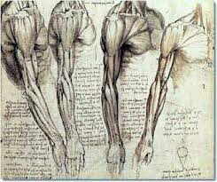
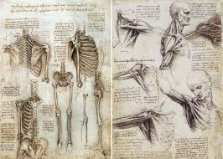
Da Vinci’s Drawings

Slide 12
The 16th, 17th, and 18th Centuries
Physicians were learning more and more about the human body
A major development was the invention of the microscope by Anton van Leeuwenhoek
Even though they didn’t know it, physicians were looking at germs that cause disease.
At the end of the 18th century, Edward Jenner developed a vaccine to prevent smallpox, a deadly disease.
The average life span increased to 40 to 50 years.
Notes:
-William Harvey described the circulation of blood, Gabriel Fallopius described the fallopian tubes of a female.

Slide 13
The 19th Century
This was the period known as the Industrial Revolution. Major progress occurred because of the development of machines and access to books.
Physicians began to associate the tiny microorganisms seen in the microscope with diseases.
The average life span increased to 50 to 65 years.

Slide 14
The 20th Century
This period showed the most rapid growth in health care.
Physicians were able to use new machines such as X-rays to view the body.
Medicines, including antibiotics to fight infections, were developed.
Surgical techniques have provided cures for what were once fatal conditions.
Computers are used in every aspect of health care.
The average life span is 60 to 80 years.

Slide 15
What’s Next?
Research with stem cells and development of cloned cells could lead to treatments that will cure many diseases.
Bioterrorism (the use of microorganisms to infect humans) is a real threat.
New viruses could mutate and cause worldwide epidemics.
The World Health Organization (WHO) is constantly monitoring health problems throughout the world.

Slide 16
Current Event - Syria

