Slide 1
How To Do A Dihybrid Cross Using A Punnett Square
Bio 30

Slide 2
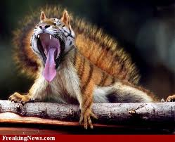
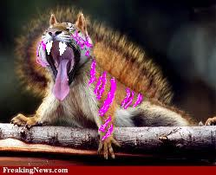
Here is a squirrelgur. The male is homozygous dominant for black stripes and small fangs. The female is homozygous recessive and has pink stripes and large fangs.

Slide 3
What letters would you use for the alleles?
How about “B” for black stripes and “F” for small fangs. (these are the dominant traits) So, we would have “b” for pink stripes and “f” for big fangs for the recessive alleles. What would be the results if we mated these two together? What would be the genotype of their offspring? What would they look like?
B = black stripes
b = pink stripes
F = small fangs
f = big fangs

Slide 4
Set up the alleles for the Squirrelgur
The male would be BBFF and the female would be bbff. Each can put only one of each type of allele into their reproductive cells. So all the male gametes would have “B” and “F” alleles. All the female gametes would have “b” and “f” alleles. When they combined the only combination every offspring could have would be BbFf. They would all be hybrids. All the offspring would have black stripes and small fangs.
The male is homozygous dominant for black stripes and small fangs = BBFF
The female is homozygous recessive for pink stripes and large fangs = bbff

Slide 5
Here is the Punnett Square for the cross of the homozygous parents
BF
BF
BF
BF
BbFf | BbFf | BbFf | BbFf
BbFf | BbFf | BbFf | BbFf
BbFf | BbFf | BbFf | BbFf
BbFf | BbFf | BbFf | BbFf
bf
bf
bf
bf

Slide 6
What would happen if we crossed two of the hybrids together? Set up your alleles (use the foil method). And then fill in your Punnett square. Please give the # of each type of offspring produced
F1: BbFf x BbFf
F1 Genotypes: ???
F1 Phenotypes: ???
F1 Phenotypic Ratio: ???

Slide 7
The Foil Method
B
b
F
f
First = BF
Outer = Bf
Inner = bF
Last = bf
B = black stripes
b = pink stripes
F = small fangs
f = big fangs

Slide 8
For both the male and the female, gametes could be: BF, Bf, bF, bf
Now, put male alleles across the top of the Punnett square and female alleles down the side. Combine the pairs to see the geneotypes of the possible offspring. Analyze results to figure out the phenotypes of the offspring.

Slide 9
Here is the Punnett Square for the cross of the heterozygous F1 generation = BbFf x BbFf
_____
_____
_____
_____
_____
_____
_____
_____

Slide 10
BF
Bf
bF
bf
BBFF | BBFf | BbFF | BbFf
BBFf | BBff | BbFf | Bbff
BbFF | BbFf | bbFF | bbFf
BbFf | Bbff | bbFf | bbff
BF
Bf
bF
bf

Slide 11
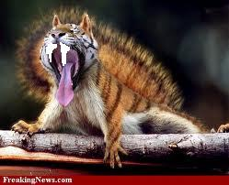
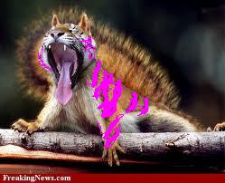
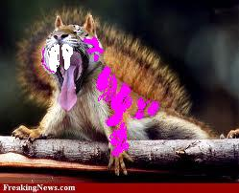
BF
Bf
bF
bf
BBFF | BBFf | BbFF | BbFf
BBFf | BBff | BbFf | Bbff
BbFF | BbFf | bbFF | bbFf
BbFf | Bbff | bbFf | bbff
BF
Bf
bF
bf

Slide 12
What would happen if we crossed two of the hybrids together? Set up your alleles (use the foil method). And then fill in your Punnett square. Please give the # of each type of offspring produced
F1: BbFf x BbFf
F1 Genotypes:
BBFF, BBFf, BbFF, BbFf, BBff, Bbff, bbFF, bbFf, bbff
F1 Phenotypes:
9 x black stripes & small fangs 3 x pink stripes and little fangs
3 x black stripes and big fangs 1 x pink stripes and big fangs
F1 Phenotypic Ratio: 9:3:3:1

