Slide 1
The Menstrual Cycle

Slide 2
Overview
Menstruation is the shedding of the innermost lining of the uterus (the endometrium).
This process of shedding is accompanied by bleeding.
Menstruation occurs in approximately monthly cycles throughout a woman’s reproductive life, except during pregnancy.
Menstruation begins during puberty – the first occurrence of menstruation is called menarche – and stops permanently at menopause.

Slide 3
The Menstrual Cycle
The menstrual cycle begins with the first day of bleeding, which is counted as day 1.
The cycle ends just before the next menstrual period.
Menstrual cycles typically range from 25 to 36 days.
Only 10-15% of women have a cycle that is exactly 28 days.
In at least 20% of women, cycles are irregular.
Menstrual bleeding lasts 3 to 7 days, averaging 5 days.
Blood loss from menstrual bleeding usually ranges from ½ to 2 ½ ounces.
Menstrual bleeding is often accompanied by a range of symptoms, including cramping, bloating, breakouts, sore breasts, tiredness, and mood swings.

Slide 4
The Menstrual Cycle Phases
The menstrual cycle is regulated by the complex interaction of hormones: follicle stimulating hormone, luteinizing hormone, and progesterone and estrogen.
As a result of the interaction of these hormones, the menstrual cycle goes through three phases:
Follicular
Ovulatory
Luteal

Slide 5
The Follicular Phase
When the follicular phase begins, levels of estrogen and progesterone are low.
As a result, the top layers of the thickened lining of the uterus break down and are shed through menstruation.
Around this time, levels of follicle stimulating hormone increase slightly, which stimulates the development of several follicles in the ovaries.
Each follicle contains an egg (ovum).
Later on in this phase, the levels of follicle stimulating hormone decrease and only one follicle continues to develop.
The developed follicle produces estrogen.

Slide 7
The Ovulatory Phase
The ovulatory phase begins with a surge in follicle stimulating hormone and luteinizing hormone.
Luteinizing hormone stimulates egg release (ovulation), which usually occurs 16-32 hours after the hormone surge.
The estrogen levels peak during the surge and progesterone levels start to increase.
One egg is released from one ovary per cycle – the ovaries will rotate which releases an egg.

Slide 9
The Luteal Phase
Luteinizing hormone and follicle stimulating hormone levels decrease.
The ruptured follicle closes after releasing the egg and produces a corpus luteum, which releases progesterone.
During most of this phase, progesterone levels are high.
Progesterone and estrogen cause the lining of the uterus to thicken in preparation for the possibility of fertilization.
If the egg is not fertilized the corpus luteum deteriorates and no longer produces progesterone.
Estrogen levels decrease.
The top layers of the uterine lining break down and are shed in menstruation, signaling the beginning of a new menstrual cycle.

Slide 12
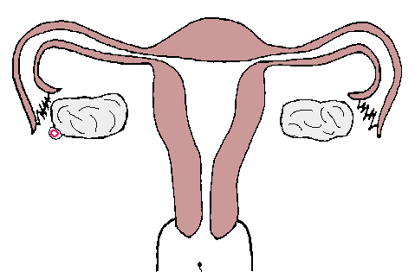
If an egg is fertilized…
The ovum then becomes a zygote.
The zygote implants into the wall of the uterus, and develops into a fetus.
The menstrual cycle ceases for 40 weeks as the fetus develops into a baby.
40 weeks later, the baby is born!

