Slide 2
In Motion manitoba annual resources
Ltad across sports

Slide 3
PHYSICAL LITERACY ASSESSMENT

Slide 4
PHYSICAL LITERACY ASSESSMENT
Passport for Life
PLAY Tools
60 minutes Kids Club
CAPL Tool
Notes:
Will be talking about the first two
Canada is the only country that has PL Assessment tools
Canadian Assessment of Physical Literacy

Slide 5
Why measure?
Research
Program evaluation
Assessment for learning (formative)
Teaching tool
Assessment of learning
Surveillance
Engagement & Awareness
Marketing
Normative data
Notes:
Physical literacy does not equal DPA, body comp, PE, fitness…all different terms…sectors grappling with these terms and interchanging terms..
Engagement and awareness – getting ‘buy in’ through completion of the tools…awareness before engagement
Normative data - what does normal data look like – but most people are inactive…
Program evaluation – efficacy study
Research – requires ethics…
Teachers don’t need to know whether they are delivering the curruculum
Survellance – need repeated measures over time, often tied to normative data..

Slide 6
http://passportforlife.ca

Slide 7
Passport for Life has four components
Self report of Participation
Self report of Life Skills
Objective assessment of Fitness
Core strength
CV fitness
Dynamic balance
Objective assessment of Movement
Locomotor task
Catch and throw task
Kicking tasks

Slide 8
www.physicalliteracy.ca/PLAY

Slide 9
PLAY Tools
Physical Literacy Assessment for Youth Tools
PLAY Fun - an “objective” assessment of physical literacy
PLAY Self - a self report of physical literacy (child)
PLAY Inventory - a self reported checklist of participation (child)
PLAY Coach - a surrogate report of a child's physical literacy (PE teacher)
PLAY Parent - a parental report of the child's physical literacy (parent)
www.physicalliteracy.ca/PLAY

Slide 10
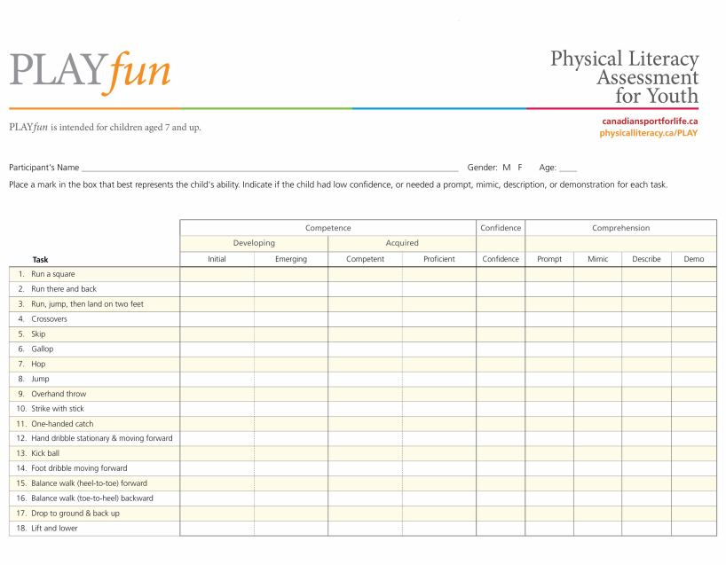
Play Fun handout picture
Notes:
Used from 4 yrs old and up (no cap)

Slide 11
PLAY Fun
Movement Vocabulary
18 land based skills/tasks – curricular linked
Motor Competence
Confidence
Flag for low
Comprehension
Prompt, mimic, describe, demonstrate
Notes:
Each Skill is assessed along the continuum of a 100 mm visual analogue scale. Each end of the scale is bounded from not performing the skill all the way to fully proficient in the skill. The scale can be further divided by the midpoint of the scale indicating a yes/no acquisition of the skill. If a child does not understand the scripted instructions, a prompt may be offered, followed by an alternate description and a demo if needed. If any of these are required it is indicated on the scoring sheet.
Children in groups up to 4 can be assessed in 15 minutes. One session is required. Standardized procedures are followed for PLAY administration. These include a) Scripted instructions b) No practice of or verbal description of the skills can be delivered to the individual being tested in advance of the test.
c) Evaluators must be skilled at assessing body movement –d) the use of and number of verbal prompts will be recorded on the score sheet.
HOLISTIC RUBRIC: not using criterion; similar to marking a term paper A, B, C,; give ‘examplars’ of each category (schema for the holistic rubric is agreed upon by all assessors, and then all are trained in this agreed upon schema)
Get 25mm of wiggle room for each category; >50mm: ‘ACQUIRED MOVEMENT VOCAB’
Worst scenario: Confidence Flags 18x1=18
: Comprehension Flags 18x4=72

Slide 13
PLAY Self
Provides:
Self-report of a child’s own perceived physical literacy and related domains
Separated into 3 sections
Participation in environments
Sub-domains of PL
(self-efficacy, confidence, comprehension, worry, eagerness, etc)
Relative importance of literacy, numeracy and physical literacy
Notes:
Self-efficacy is the extent or strength of one's belief in one's own ability to complete tasks and reach goals. This can be seen as the ability to persist and a person's ability to succeed with a task. As an example, self-efficacy directly relates to how long someone will stick to a workout regimen or a diet. High and low self-efficacy determine whether or not someone will choose to take on a challenging task or "write it off" as impossible.
Self-esteem is used to reflect a person's overall emotional evaluation of his or her own worth. It is a judgment of oneself as well as an attitude toward the self. Self-esteem encompasses beliefs (for example, "I am competent," "I am worthy") and emotions such as triumph, despair, pride, shame.
Self-confidence is a feeling of trust in one's abilities, qualities, and judgment.

Slide 14
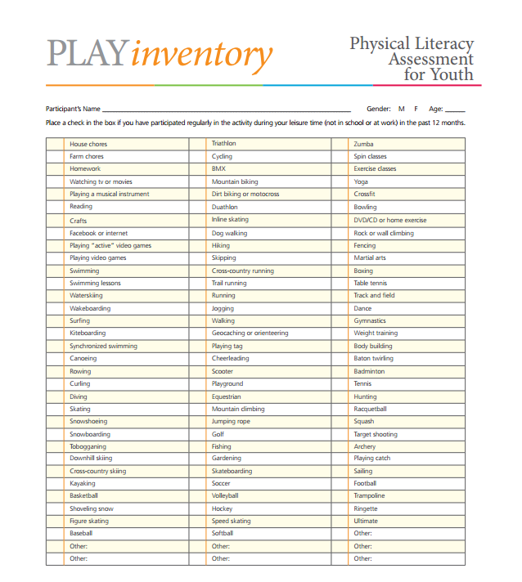
PLAY Inventory
Provides:
#of active skills
Environments
Type of activities
Team/individual
Intensity level
Environment
Competitive/
Non-competitive

Slide 15
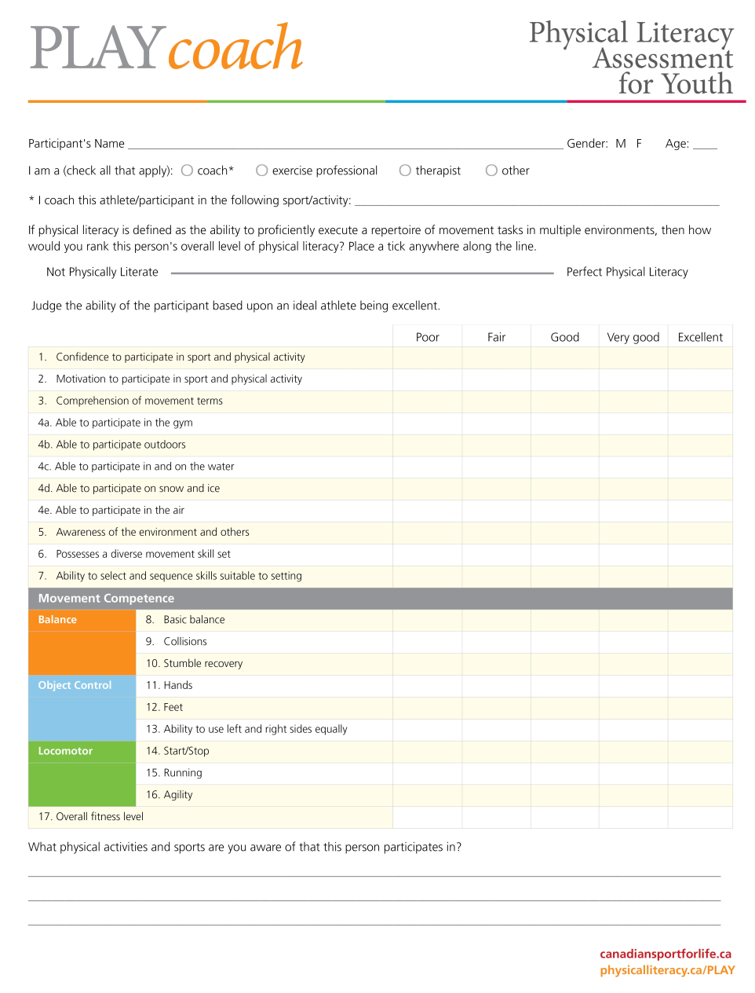
PLAY Coach
Surrogate assessment
Mini-PL motor competence assessment (subjectively)

Slide 16
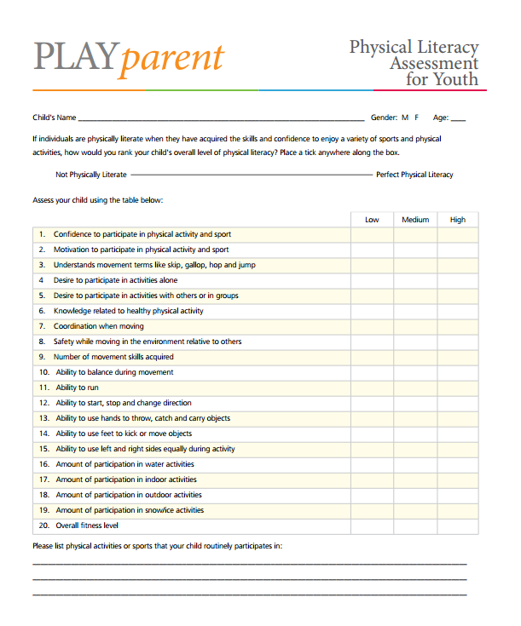
PLAY Parent
Scale used is parent friendly (L, M, H)
Overlapping constructs with PLAY Self & Coach

Slide 17
PLAY Tools
Reliable, Valid, Meaningful, Sensitive
PLAY Fun – Objective PL Assessment
0.68-0.92 TRT
0.78-0.87 IRT
0.82 TGMD2 – concurrent validity
PLAY Inventory – Participation inventory
0.55-0.78 TRT, age
PLAY Self – Self Assessment of PL
0.63-0.88 TRT, age
PLAY Coach – Surrogate recall assessment of PL
0.84-0.91 TRT, skill
PLAY Parent – parental assessment of child’s PL
0.65-0.81 TRT, sex of parent
Notes:
Tools went under extensive reliability and validity testing.
>0.7= good test-retest reliability
with younger age groups, a lower number is seen (with AGE: Play Inv & Self improves with ability to fill it out)
With SKILL (of coach for ax mvmt & having mvmt knowledge)
PLAY Tools are GOOD to EXCELLENT
Also: Meaningful & Interpretable: Link to PE curricular objectives
Sensitive: less than 1 week of intervention needed to see a difference (?discriminative validity)

Slide 18
Task 1 – complete / Goals

Slide 19
TASK 2 – Environments

Slide 22
MB PE Curriculum Expectations
Notes:
What’s shown in PLAY tools to be acquired
Grades K-4: basic motor skill acquisition, with knowledge of why, what, and how
Grades 5-8: functional use of the skill while participating in a variety of activities in different environments/settings

Slide 23
PLAY Fun -Movement Skill/Task | Grade 4 PE | Grade 5 PE
Run a square | X | X
Run there and back | X | X
Run, jump, land on 2 feet | Jump & land 2 feet | X
Crossovers | X | X
Skip | X | X
Gallop | X | X
Hop | X | X
Jump | X | X
Overhand throw | X | X
Strike with stick | X | X
One-handed catch | Catching | X
Hand dribble stationary & moving forward |  | X
Kick ball | X | X
Foot dribble moving forward | Dribbling using feet | X
Balance walk (heel to toe) forward | X | X
Balance walk backward | X | X
Drop to ground & back up | ? | ?
Lift and lower | ? | ?

Slide 24
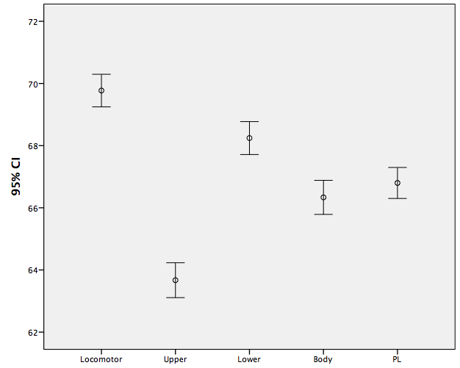
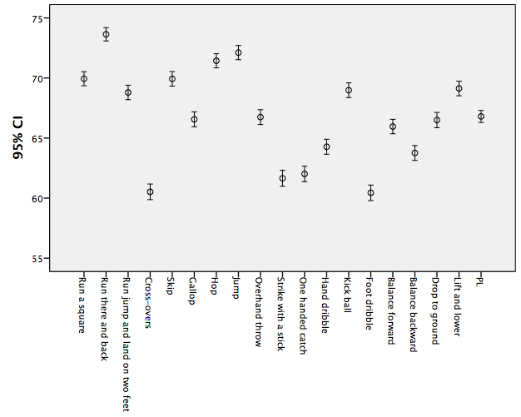

Slide 25
Running
Emerging (up to 3 years)
Developing
3 to about 8 where mature form can be achieved
Mature form (grade 5)
Competence
Speed of running still increases!! even if you meet basic age related milestones for mature form of running
Expert mastery or full proficiency (Age 25 – 29) – H. Bolt.

Slide 26
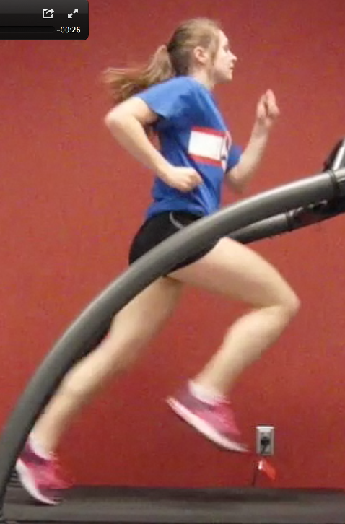
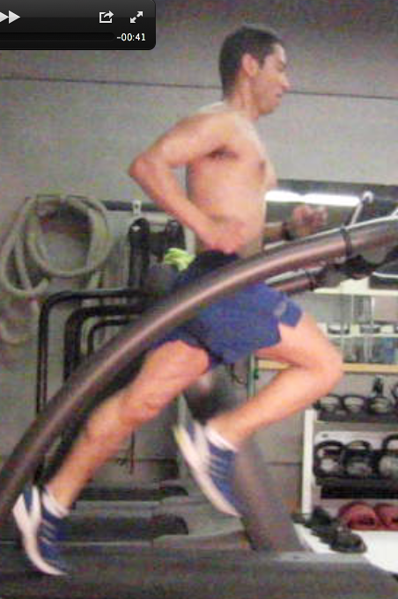
Notes:
Show videos a few time – discuss the difference between FMS and physical literacy using these examples.
Understand the difference between “mature form” of a FMS and physical literacy
Familiarize with terms of assessment using videos
Initial
Emerging
Competent or “Acquired”
Proficient
Differentiate between “identification of deficits in form—locomotionis more than just straight line motion ” and “ability to participate through physical literacy”

Slide 27
MOVEMENT PREPARATION

Slide 29
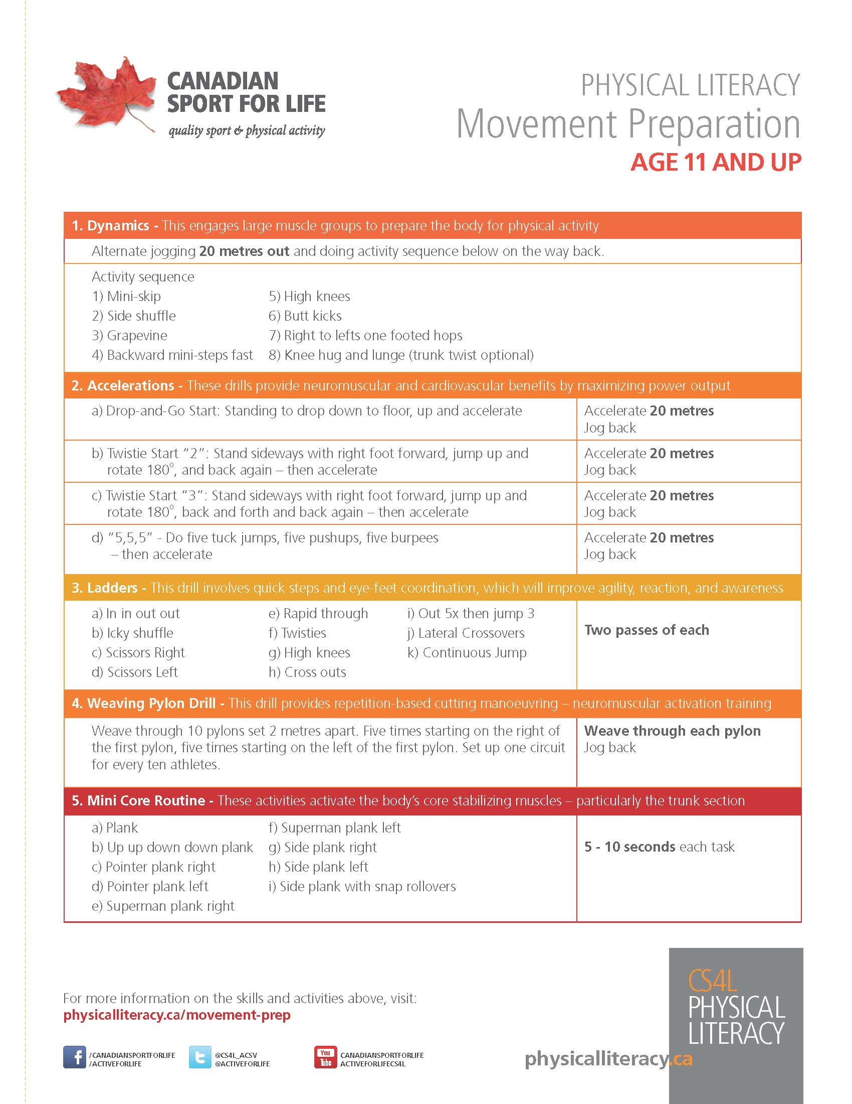

Slide 31
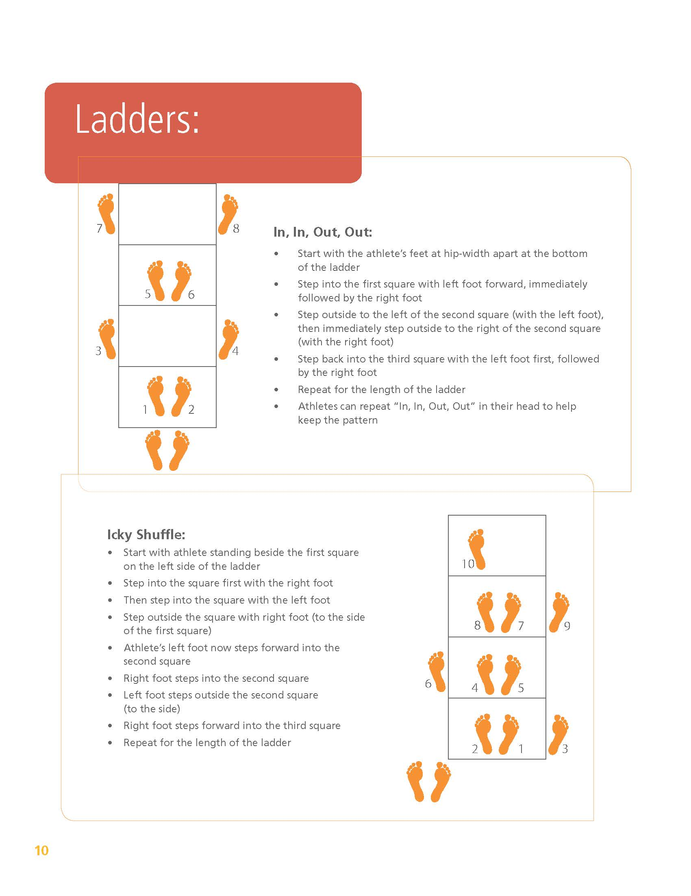

Slide 32
MOTOR CONTROL ERROR
ERROR 1
BRAIN FAILS TO ASK THE MUSCLE TO DO
BRAIN TRAINING
REPETITION BASED LEARNING WITH KNOWLEDGE OF RESULTS
PERTURBATION MANAGEMENT
ERROR 2
MUSCLE FAILS GIVEN APPROPRIATE NEURAL INPUT
MUSCLE TRAINING
CLASSIC STRENGTH AND ENDURANCE TRAINING

Slide 33
Physical Literacy Training Guidelines
Strength training guidelines
Endurance training guidelines
Aerobic training guidelines
Flexibility training guidelines
Speed, Agility and Quickness guides
Body composition guidelines
PHYSICAL LITERACY GUIDELINES
Motor control principles
Not equivalent to any of the existing guidelines

